Slide 1
Managing DCAA Audits
Laura Davis
Premier Consulting & Integration

Slide 2
Finance Webinar Series
8/19/25 - Finance for the Small Government Contractor
8/26/25 - Pricing for Government Contractors
Contact us at info@pci.us for more information!

Slide 3
Defense Contract Audit Agency
DCAA provides audit and financial advisory services to DoD and other federal entities responsible for acquisition and contract administration. DCAA’s role in the financial oversight of government contracts is critical to ensure DoD gets the best value for every dollar spent on defense contracting. DCAA operates under the authority, direction, and control of the Under Secretary of Defense (Comptroller)/Chief Financial Officer. Its work benefits our men and women in uniform and the American taxpayer. The Agency’s primary function is to conduct contract audits and related financial advisory services. Contract audits are independent, professional reviews of financial representations made by defense contractors, and DCAA helps determine whether contract costs are allowable, allocable, and reasonable.

Slide 4
Who Performs the Audit
DCAA
Agency Personnel
CPA Firms

Slide 5
Common Types of DCAA Audits
Accounting System Review
Proposal Pricing
Incurred Cost Submission
Timesheet Floor-check
Financial Capability
Public Voucher Review
Purchasing System Review

Slide 6

Accounting System Review
Pre-award or Post-award
Verifies accounting system is ‘adequate’ to perform cost-type contracts
Review design and use of accounting system
Trace transactions through the system
Review policies/procedures
Pass or Fail – no longer issuing recommendations

Slide 7

Pricing Audits
Verify the cost/pricing data is fair and reasonable.
Review source of proposed direct costs
  Labor based on actual employee data, Wage Determination/Collective Bargaining Agreement, offer letter, or paid salary survey
  Non-labor based on vendor quotes (should have more than one quote)
Review proposed indirect rates
  Current year and forward pricing rates
  Compare to prior year actual rates
  Explain variances
Profit or Fee is not audited

Slide 8
Incurred Cost Submission Audits
Audit the actual ICS in accordance with accounting system and contract provisions
Sampling of transactions
Looking for unallowable costs
Looking for billing based on contract provisions
Audit report will be used to establish final billing rates for contract close-out

Slide 9
Timesheet Floorchecks
Review timekeeping policy
Interview employees on the use/knowledge of timesheets and timekeeping policy
  Verify timesheets are completed daily
  Verify corrections are tracked by either marking through or electronically
  Verify completes and signs their own timesheet
  Verify proper approvals
  Discuss employees’ knowledge of charge codes
  Flow through system to payroll check

Slide 10
Financial Capability Audit
Determines if company has the financial capability to perform contract
Review financial statements for ability to fund contract
Review borrowing instruments such as lines of credit

Slide 11
Public Voucher Review
Verify invoices to government are correct
Review in accordance with contract provisions
Flow transactions from source document to billing to payment

Slide 12

What Triggers an Audit?
Submission of a proposal
Contracting Officer Request
Internal Control weakness found during other audit
Incurred Cost Submissions based on fiscal year

Slide 13
Audit Process
Notification
Entrance Conference
Audit Program
Audit Performance
Exit Conference
Audit Report

Slide 14
Notification/Entrance Conference
Contracting Officer requests the audit
DCAA contacts contractor with preliminary request including Internal Control Questionnaire
May request other documents in advance depending on type of audit
Entrance Conference to provide overview of audit, timing, scope, etc.
Contractor should obtain audit program to follow along

Slide 15
Audit Programs
Audit Programs can be found on DCAA’s website
  www.dcaa.mil
Ask the auditor for specific program
Contractors should become familiar with the audit program to understand what is required
Contractors should also know what is not part of the audit program

Slide 16

Audit Performance
Varies depending on type of audit
Generally, involves sampling transactions to flow through the system
DCAA may want to physically observe the ‘pulling’ of the transactions
Follow-up Questions

Slide 17
Exit Conference/Audit Report
Request an exit conference to understand their findings
Some audits are communicated through a preliminary report where Contractor can document their response
Final audit reports are issued to CO
  Contractor may request copy from CO
ICS triggers final indirect rate agreement

Slide 18
Basic Issues of a DCAA Audit
Proposed Costs – How did you arrive at the amounts (labor rates, hours, travel, etc) that you proposed.
Invoiced – Provide actual data to substantiate the costs/hours.
  Cumulative Incurred vs Cumulative Billed
Close-out – Provide actual data to substantiate the transactions making up the costs/hours.

Slide 19
RecordKeeping and DCAA Audits
The burden of proof is on the contractor.
If you can’t provide the documentation, the costs will be disallowed.
Segregation of costs within accounting system is extremely important.
  Direct vs. Indirect
  Breakout of indirect costs by pool
  Unallowables

Slide 20

RecordKeeping and DCAA Audits
Audit period can be 1-3 years in arrears
Contractor must maintain records for 5 years after close-out.
Maintain detailed records
  Complete backup
  Easily accessible
  Approvals

Slide 21
RecordKeeping and DCAA Audits
Normal accounting process should include:
  Make sure accounts payable documentation has invoice, purchase order, packing slip, and all approvals.
  Make sure all timesheets have signatures. Corrections should be marked out with a single line and initialed.
  Subcontract agreements should be well-maintained. The invoices should also disclose work performed. Period of performance and subcontract values should be monitored.
  Contract and modifications must be easily located. You may want to brief contracts as they are awarded and modifications are issued.

Slide 22
RecordKeeping and DCAA Audits
Journal entries should have documentation attached.
  Show approval of journal entries
Make sure your invoice to the government matches the documentation from AP, Timesheets, Subcontractors, etc.
Travel and Labor should correspond to the same category.
Policies/Procedures

Slide 23
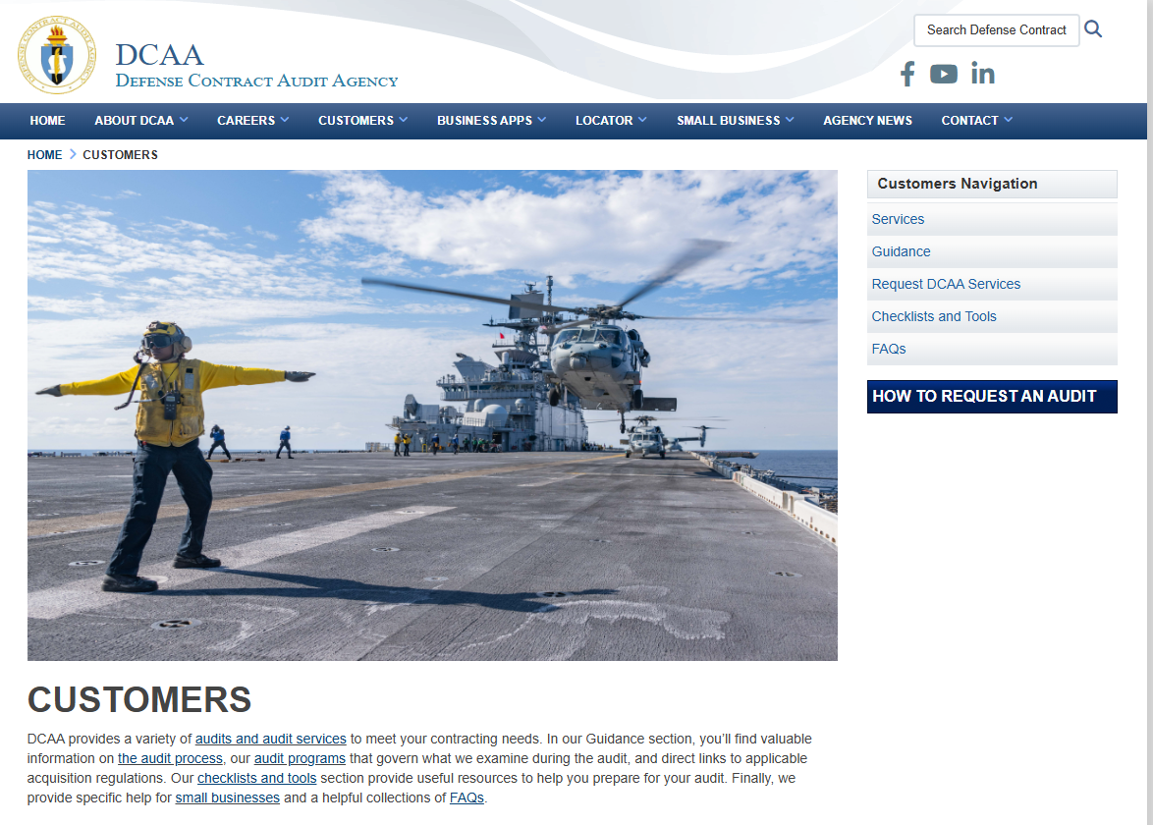
DCAA’s Website
Defense Contract Audit Agency - Home

Slide 24
Q&A
Contact us at info@pci.us for more information!

