Slide 1
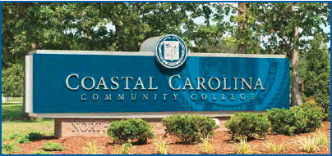

Slide 2

About Us
The objective of the Small Business Center Network (SBCN) is to increase the success rate and the number of viable small businesses in North Carolina by providing high quality, readily accessible assistance to prospective and existing small business owners which will lead to job creation and retention.

Slide 3
What We Do
Seminar Training for Business Owners and Prospective Business Owners
1:1 Confidential Small Business Counseling
  Launch support
  Business plan assistance
  Business research support
Resources and Referrals

Slide 4
Our Impact
Since FY 2019-2020
5th in the State in business starts: 51 New Businesses
4th in the State in Job Creation & Retention: 297 Jobs Created & 308 Jobs Retained
2nd in the State in Training Events Held: 775 Seminars
3rd in the State in Seminar Attendance: 10,014
1st in the State in Training Seat Hours: 33,922.50
*More Small Business Center Training Occurs at Coastal Carolina than anywhere else in the state!
4th in the State in Unique Businesses Served: 1,052 Clients
5th in the State in Counseling Hours Provided: 3,806.25 Hours
Ranking is based on results from 58 NC Small Business Centers

