Slide 1

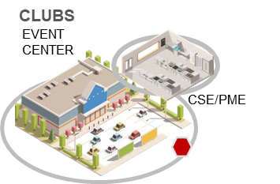

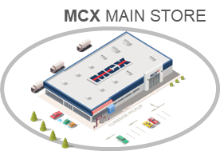



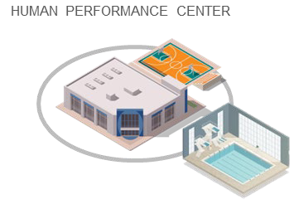
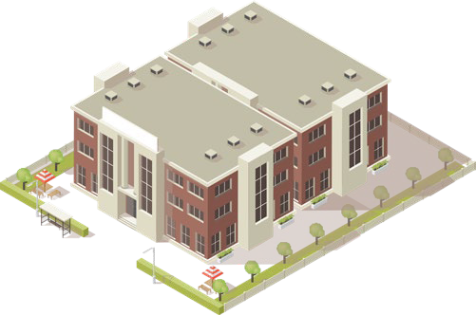
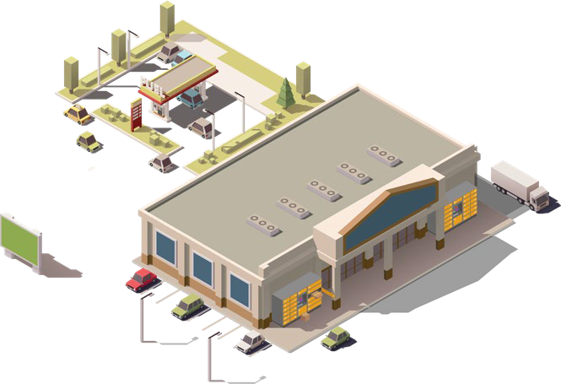
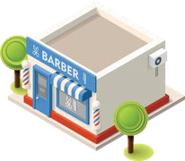
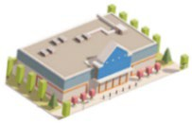

Marine Corps Installations East (MCI East)
Marine Corps Community Services
ABOUT MCCS LEJEUNE-NEW RIVER
Service provider for both MCB Camp Lejeune and MCAS New River.
Staff section of MCIEAST and part of the larger enterprise within the United States Marine Corps.
Unique and independent from MCAS Cherry Point, MCLB Albany, and MCAS Beaufort, however, regional opportunities for procurement and services exist.
MISSION
The MCCS mission is to make significant lasting contributions to combat readiness through the personal and family readiness of our Marines and their families. MCCS maintains mission readiness and productivity through programs that promote the physical and mental well being of all members of the Marine Corps, including active duty, reserve, retired, and civilian.
NONAPPROPRIATED FUND PROCUREMENT
Important Notes
No centralized repository or location for NAF contract opportunities. Solicitations are announced and packages sent to known vendors.
Separate rules and regulations for NAF procurement.
Contracts issues at the local, regional, and enterprise-wide levels.
Examples of MCCS Procurement Opportunities
Construction (minimal).
Business storefronts (i.e., GNC, Harley Davidson Gift Shop, Furniture Distributors, HR Block, Firestone, American Clippers, Model Cleaners etc.).
Items to be sold inside the MCX retail stores.
Stand Alone Food Concepts (i.e., Taco Bell, Raisin Canes, Subway, Pizza Hut, Dominos, etc.).
Food Trucks.
Personal Services (i.e. personal training, massage therapy, photography, auto detailing, etc.).
Traditional goods and services.
CHILD DEVELOPMENT CENTER
Single Marine Program
RECREATION CENTER
Human Performance Center
SERVICES
BARBER, DRY CLEANING…
MCX MARINE MART
LIBRARY
CUI
Point of Contact: Chris Alger, 910-451-9081 christopher.alger@usmc-mccs.org
For Public Use : Distribution Unlimited

