Slide 1

How to do Business
with
NAVFAC
Small Business Outreach
Coastal Carolina Community College
31 Jul 2025

Slide 2
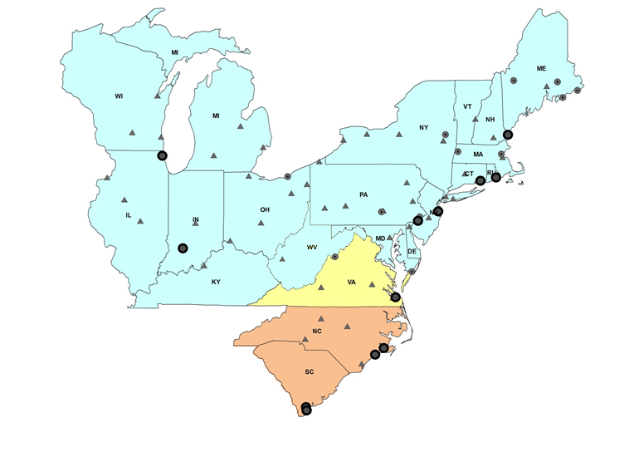














NAVFAC Mid-Atlantic AOR
SERE School Range (PWD ME)
Great Pond (PWD ME)
NCTS Cutler (PWD ME)
NSA Saratoga Springs (PWD NL)
NAVSATOPSCEN (PWD ME)
MARFORRES FST
NS Great Lakes
PWD Maine Portsmouth Naval Shipyard
PWD Great Lakes
NS Great Lakes
USS Constitution (PWD ME)
DCMA/DLA Cleveland (PWD GL)
PWD Newport NAVSTA Newport
PWD New London SUBASE New London
PWD Earle NWS Earle
NSA Mechanicsburg (PWD PA)
NSA Philadelphia (PWD PA)
PWD Crane NSA Crane
PWD Pennsylvania PNBC Annex
NSGA (former) Sugar Grove (PWD Yorktown)
NASA Wallops Island (PWD LC/FS)
PWD Oceana NAS Oceana and Dam Neck Annex
PWD JEB Little Creek-Ft Story JEBLC-FS
PWD Norfolk NAVSTA Norfolk
PWD NSA Hampton Roads NSA HR
PWD Portsmouth Norfolk NSY
PWD Yorktown NWS Yorktown and Cheatham Annex
  NOSC
  Affiliated Site (Responsible PWD)
FEAD Cherry Point MCAS Cherry Point
  PWD / FEAD / ROICC / FST
ROICC Camp Lejeune MCB Camp Lejeune
North Ops
  MIDLANT AOR
  13 PWDs - 3 FEADs - 1 ROICC
  204 Navy Sites including 39 NOSCs
  118 MC Reserve Sites (plus 79 sites out of AOR)
Hampton Roads Ops
FEAD Beaufort MCAS Beaufort
FEAD Parris Island MCRD Parris Island
Marine Corps Ops
Notes:
DATA SOURCE(s): CURRENT “AS OF” DATE:

Slide 3
What NAVFAC Buys
Planning, Design and Construction
  Construction services
  Architect & engineering services
  Design in-house
  Specialized technical services
  Ocean engineering
  Land & installation planning
  Facilities planning
  Encroachment management
  Facilities integrated logistics support
Environmental
  Environmental planning/NEPA
  Environmental compliance &
  conservation
  Environmental restoration
  Sustainable solid waste management
Expeditionary
  Civil engineering support equipment
  Logistics-over-the-shore systems
  Construction equipment and training
  Expeditionary IT systems
Public Works
  Facility sustainment
  Utility & energy management
  Base operation and maintenance
  Facility services
Real Estate
  Real Estate
  Real property acquisition, management & disposal

Slide 4
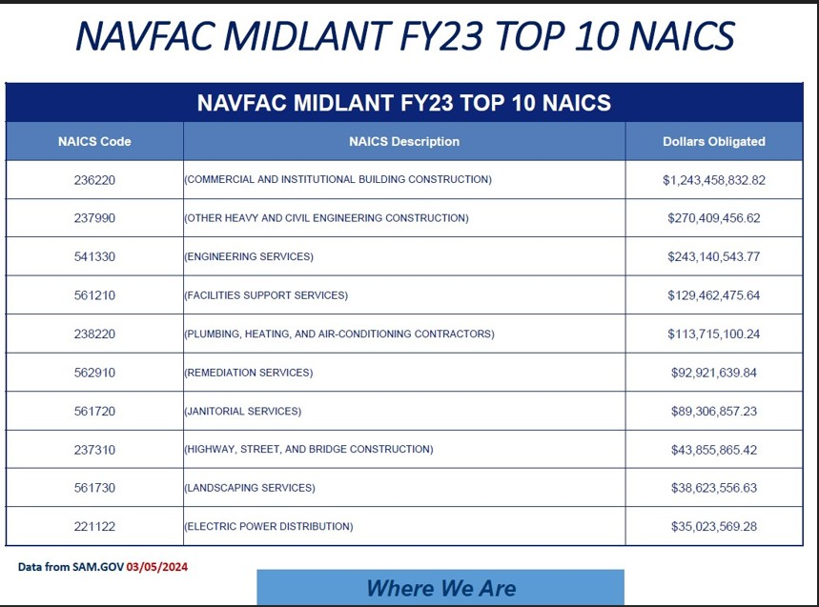

Slide 5
NAVFAC Mid-Atlantic AOR
SB Prime Targets FY24/25
Category Target Achievement
SB FY24 49.2% 56.23%
SB FY25 52% TBD
FY24 – NAVFAC Mid-Atlantic AOR awarded over $1.4B prime contracts to small business concerns.
FY25 – Do not let off the accelerator; pursue above-target achievements.

Slide 6
Target Market
In 2024 the Federal Government obligated $6.7 Trillion
Know your target market – might not be NAVFAC
Federal Procurement Data System (FPDS-NG) report generation has transitioned to www.SAM.gov under Data Bank
  Plethora of information to research what Government agencies are buying
USASPENDING.gov: https://www.usaspending.gov/#/
  Which agencies are buying your NAICS codes?

Slide 7
Useful Website Links
Federal agencies procurement forecasts:
https://www.acquisition.gov/procurement-forecasts
NAVFAC Atlantic website:
https://atlantic.navfac.navy.mil
NAVFAC Mid-Atlantic website:
https://atlantic.navfac.navy.mil/NAVFAC-Worldwide/NAVFAC-Mid-Atlantic/
NAVFAC Small Business website:
https://www.navfac.navy.mil/Divisions/Office-of-Small-Business-Programs

Slide 8
How to get involved…
Locate contracting and subcontracting opportunities:
www.SAM.gov
  Formerly FedBizOps
  NAVFAC opportunities:
    Key word/filter search for NAVFAC Atlantic: N62470
    Key word/filter search for NAVFAC Mid-Atlantic: N40085
What can be found on this site:
  Sources Sought
  Requests for Information
  Solicitations
  Outreach Events
  Other Important Information

Slide 9
Office of Small Business Programs
Promote maximum opportunity for small businesses
Advise and assist acquisition officials to ensure strategies are structured to facilitate small business utilization
Counsel small businesses to maximize opportunities to compete for DoD prime contracts and subcontracts
Analyze small business capabilities
Ensure large businesses provide adequate subcontracts to small business concerns

Slide 10
Contact Information
  Ms. Kimberly Vallone
  Assistant Deputy for Small Business
  NAVFAC Mid-Atlantic
  Kimberly.A.Vallone.civ@us.navy.mil
Notes:
DATA SOURCE(s): CURRENT “AS OF” DATE:

