Slide 1

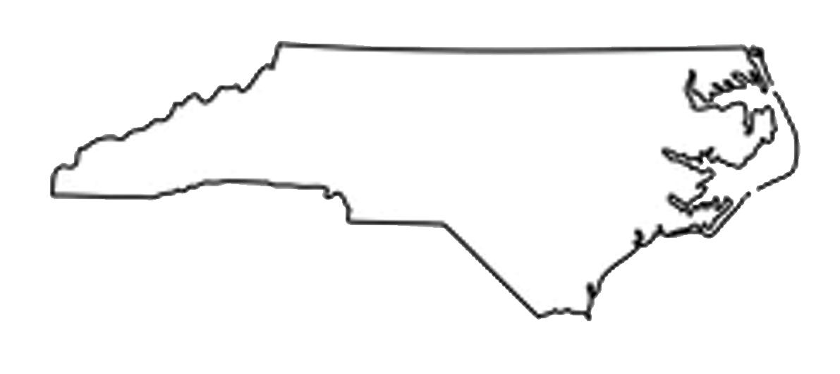
North Carolina Military Business Center
ncmbc.us DEFTECH.nc.gov MatchForce.org

Slide 2

Who We Are
Help you accomplish missions, meet Directorate requirements
Drive competition, drive down costs, beat small business goals
Engage businesses to work for the military
Provide market intel, business development, training and one-on-one technical assistance (pre- and post-award)
Promote employment: transitioning military & families
Promote installation/command - community relations
The NCMBC is a statewide, business development and technology transition entity of the State of North Carolina, embedded in the state’s community colleges and headquartered at Fayetteville Technical Community College
Totally State-funded, the NCMBC is the only statewide, military-focused economic development entity in the US, and the only NC entity solely focused on growing the defense economy through existing industry

Slide 3
Mission, Goals and Outcomes
Mission: To leverage military and federal business opportunities to expand the economy, grow jobs and improve quality of life
Goals and Operations:
1 - Increase federal revenues for businesses
2 – Support technology transition to federal agencies
3 - Support integration of military into workforce
4 - Support defense-related business recruitment
Outcomes: Contracts (6,227), revenues ($18.09 B), jobs!

Slide 4
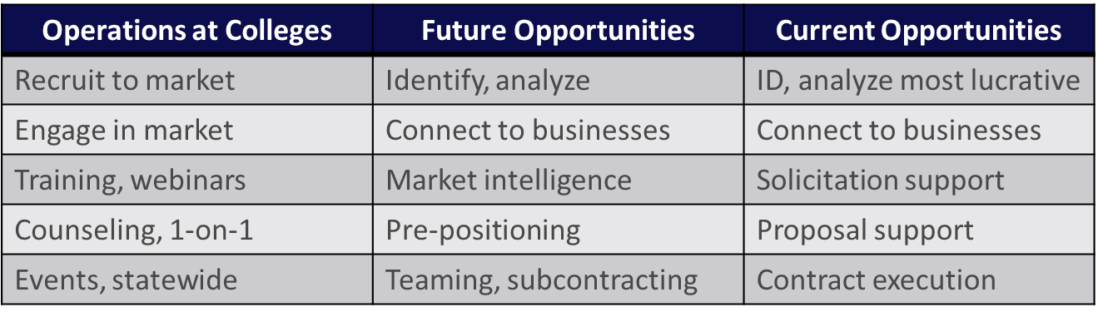
Operations: Business Development
CY2005-CY2023 | Opps Distributed: >60,000 | Connections: >40 million
BD Team-Involved Wins: over 3,300 | Total Min Value: over $13.01 billion

Slide 5
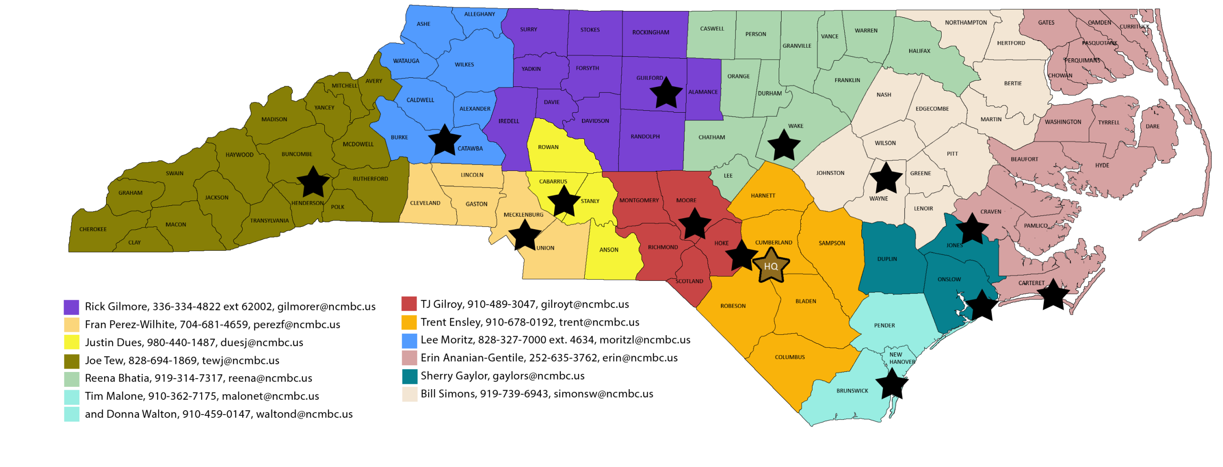
Operations: Business Development
Operations: Business Development Team

Slide 6


Slide 7



Operations: 2025 - 2026 Major Events
Federal Technologies Symposium (SEP 9-10, FAY)
Medical, Biomedical, Biodefense Symposium (SEP 24-25, Chapel Hill)
Defense Industrial Sustainment Summit (NOV 18-19, Chapel Hill)
SE Region Federal Construction, Infrastructure and Environmental Summit (APR 14-16, WIL)
Federal and Defense Textile/Tactical Equipment Summit (May 19-20, RAL)

Slide 8
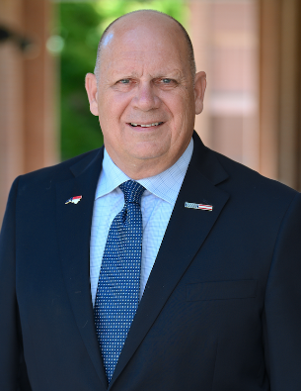
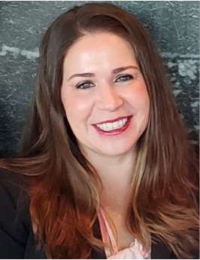
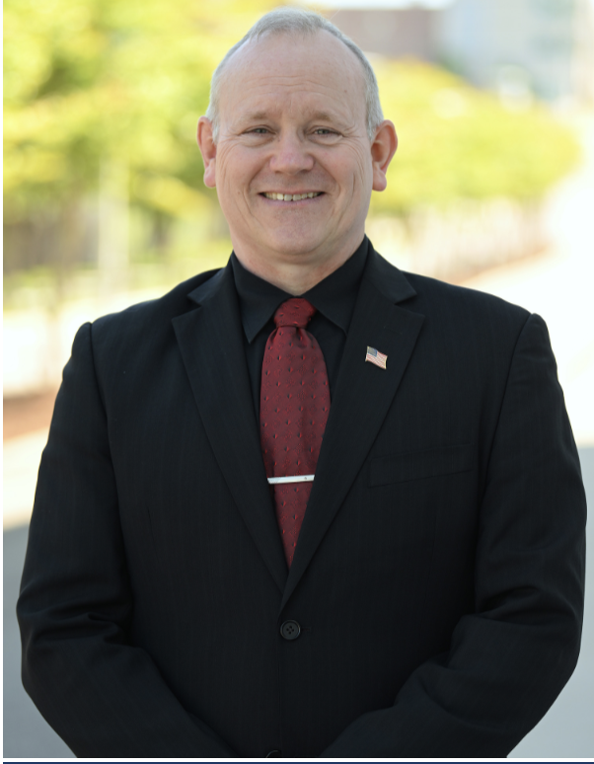
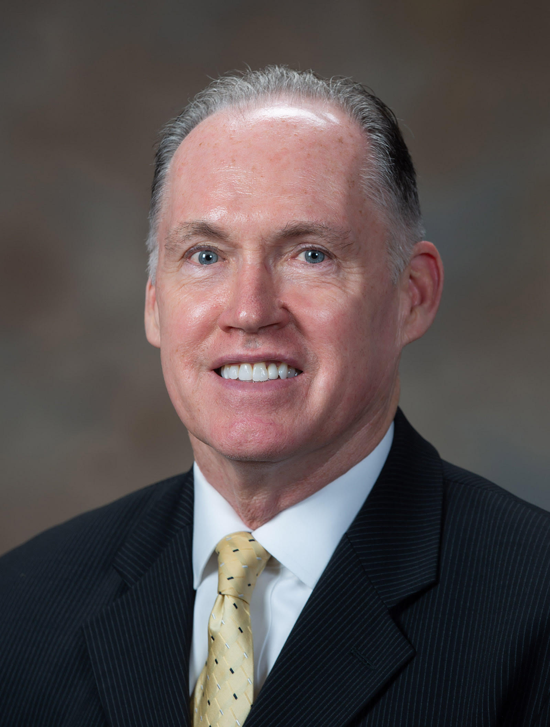
Contact Information
Scott Dorney, Executive Director, 910-678-0190, scott@ncmbc.us
Courtney Smedick, Director of Operations, 910-678-0193, courtney@ncmbc.us
Bob Burton, DEFTECH Director, 910-824-9609, burtonr@ncmbc.us
Bill Simons, Regional Program Manager, 919-739-6943, simonsw@ncmbc.us

