Slide 1
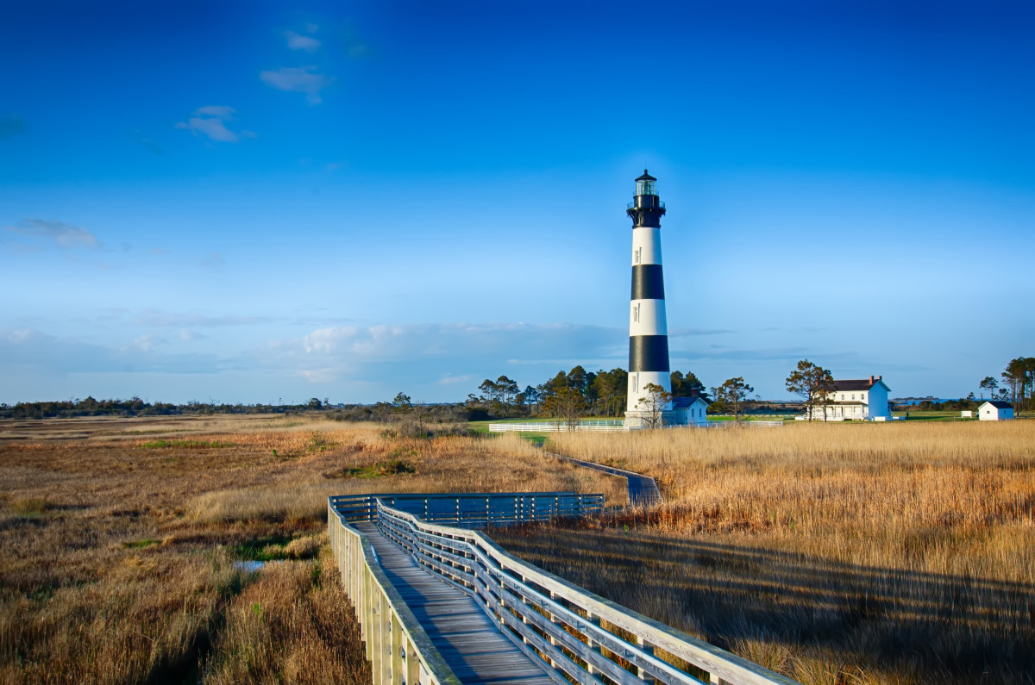



NCWorks Overview
Employment Opportunities
Elizabeth Alexander
NCWorks Career Center – Onslow County

Slide 2

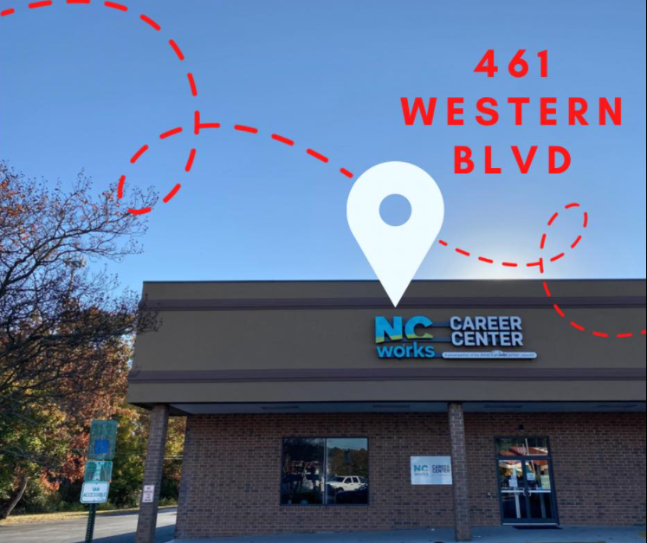
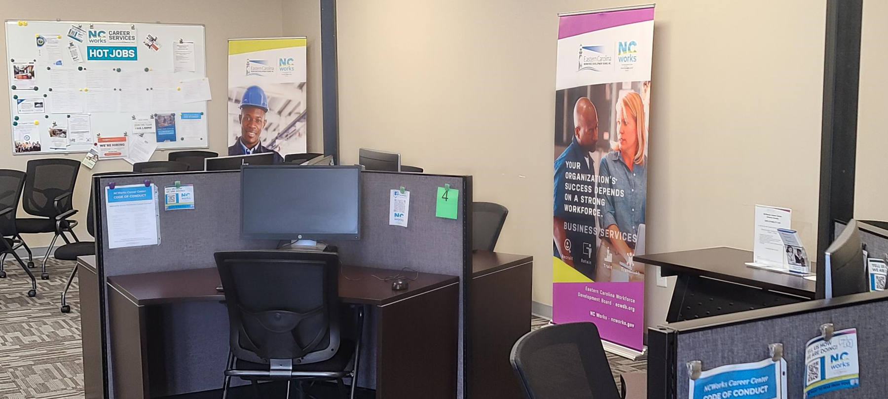
What is NCWorks?
Connecting Talent to Jobs!

Slide 3
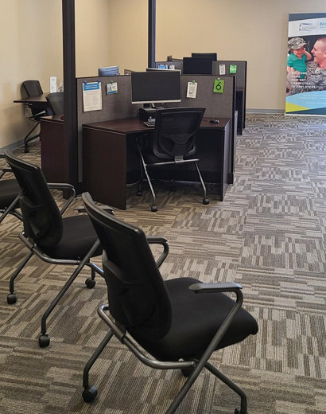
Overview of NCWorks Services
Education, Training & Employment Opportunities
Registration & overview of NCWorks Online
Career Development Workshops
Employment Search Assistance
Job Referrals
Resume Assistance
Interviewing Skills
Career Resource Center
Computers with Internet Access
Employability Lab (M-W, 8:30-12:30)
Job Search
Resume Builder
Labor Market Information
Print/Copy/Fax/Scan Services (FREE)
Hiring Events
3

Slide 4
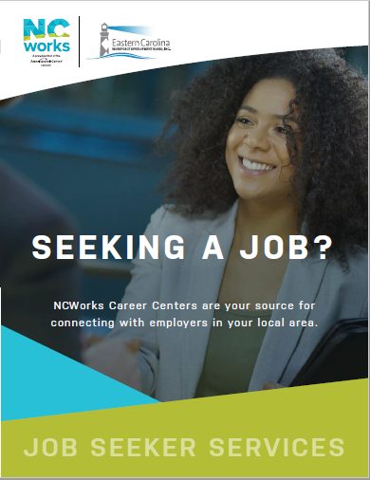
NCWorks Job Seeker Services
Talent Identification and Development
Meet with job seekers
Assess skills & interests (ex. Traitify)
Provide information on high demand jobs
Career advising
Skills development (training, work-based learning)
Connect talent to jobs
3

Slide 5
WIOA (Workforce Innovation Opportunity Act)
WIOA is a federally funded employment program
Short Term training to be completed within two years
On the-Job training is subsidized on-site employment in lieu of classroom training
Programs Include, Dislocated workers or Adults
WIOA can pay for
  Tuition
  Books
  Uniforms
  Tools
  Immunizations
  Exam Fees
Program is through Coastal Community College
For more information go to https:/www.coastalcarolina.edu/academics/con-ed/registration/financial-aid/wioa or NC works (910)-347- 2121

Slide 6

NCWorks Business Services
Employer Engagement
Meet with employers
Understand employer workforce needs
Provide labor market information
Identify and develop pipeline of talent
Structure work-based learning opportunities
Connect talent to jobs
3

Slide 7
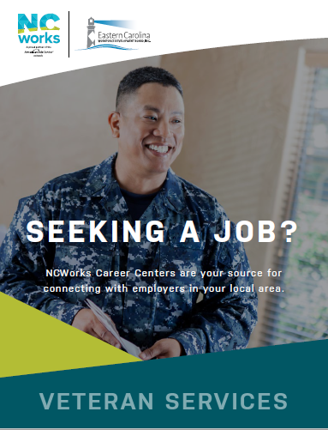
NCWorks Veterans Program Overview
Disabled Veteran Outreach Program (DVOP) Specialists
Services to Veterans (Priority of Service)
Meet with Veterans with
significant barriers to employment
3

Slide 8
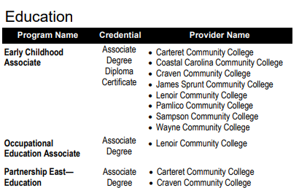

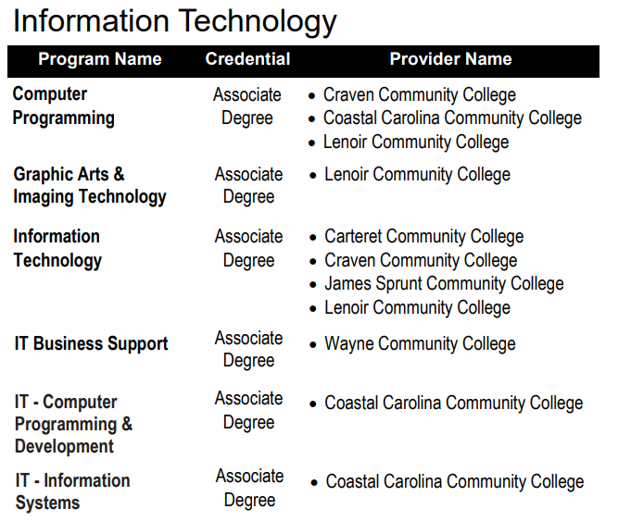
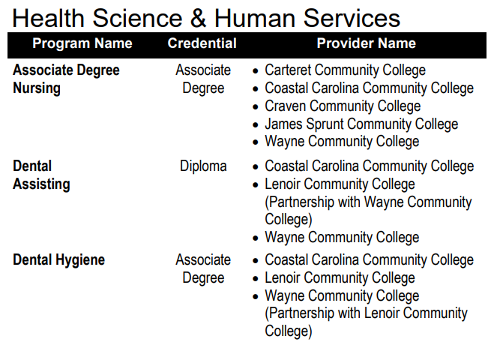
Career Pathways Training Options
3

Slide 9
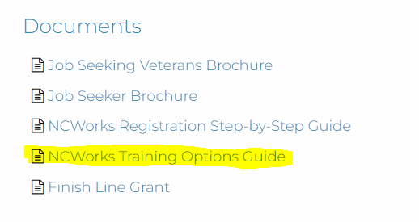

Career Pathways Training Options
www.ecwdb.org
For Individuals
Job Seeker Services
3

Slide 10
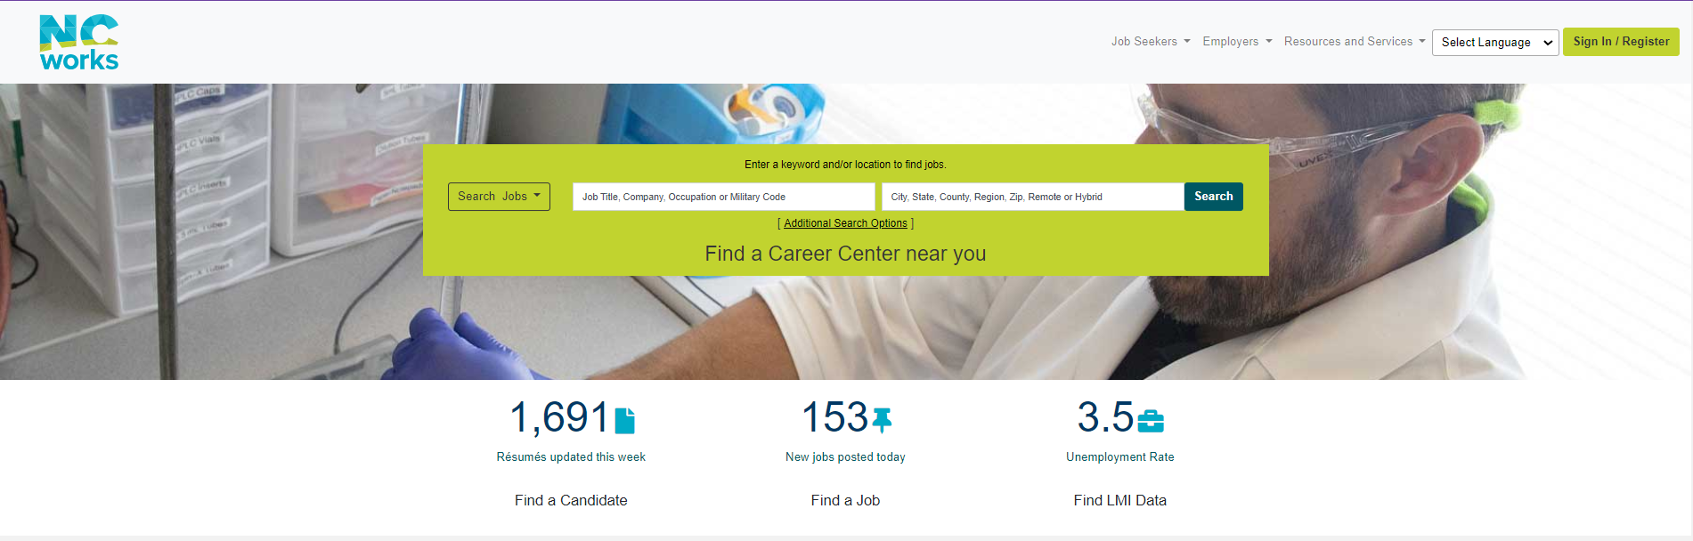
NCWorks Online
www.ncworks.gov
3

Slide 11
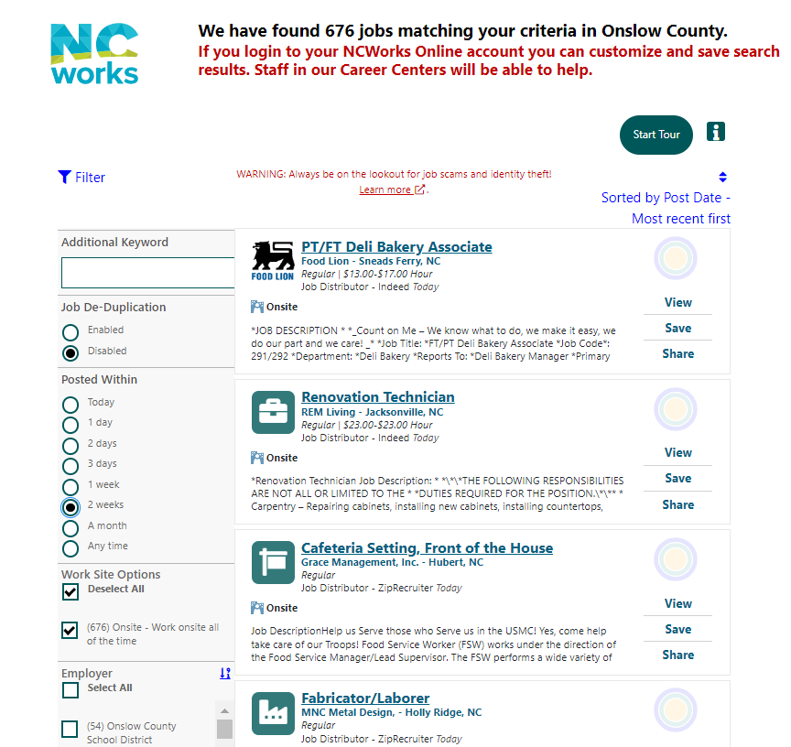
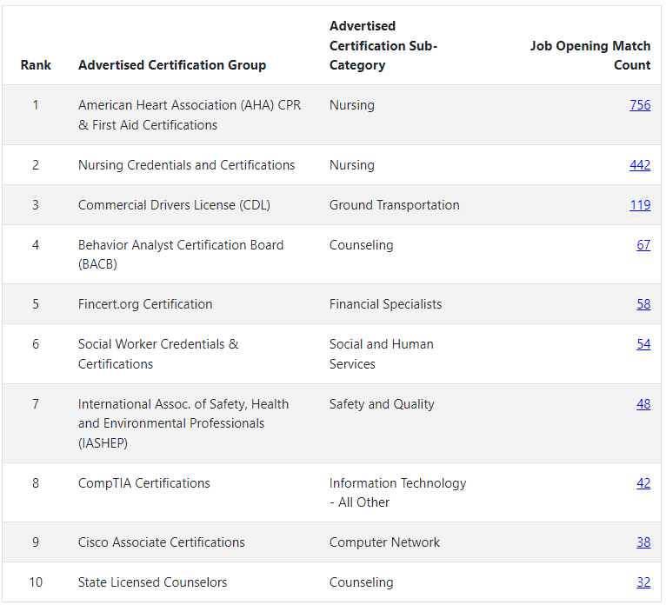
Onslow County Jobs Forecast
3

Slide 12
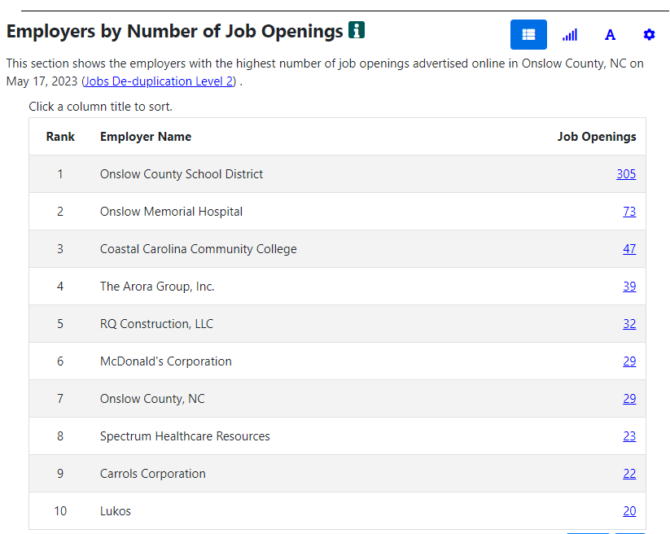
Onslow County Jobs Forecast
3

Slide 13
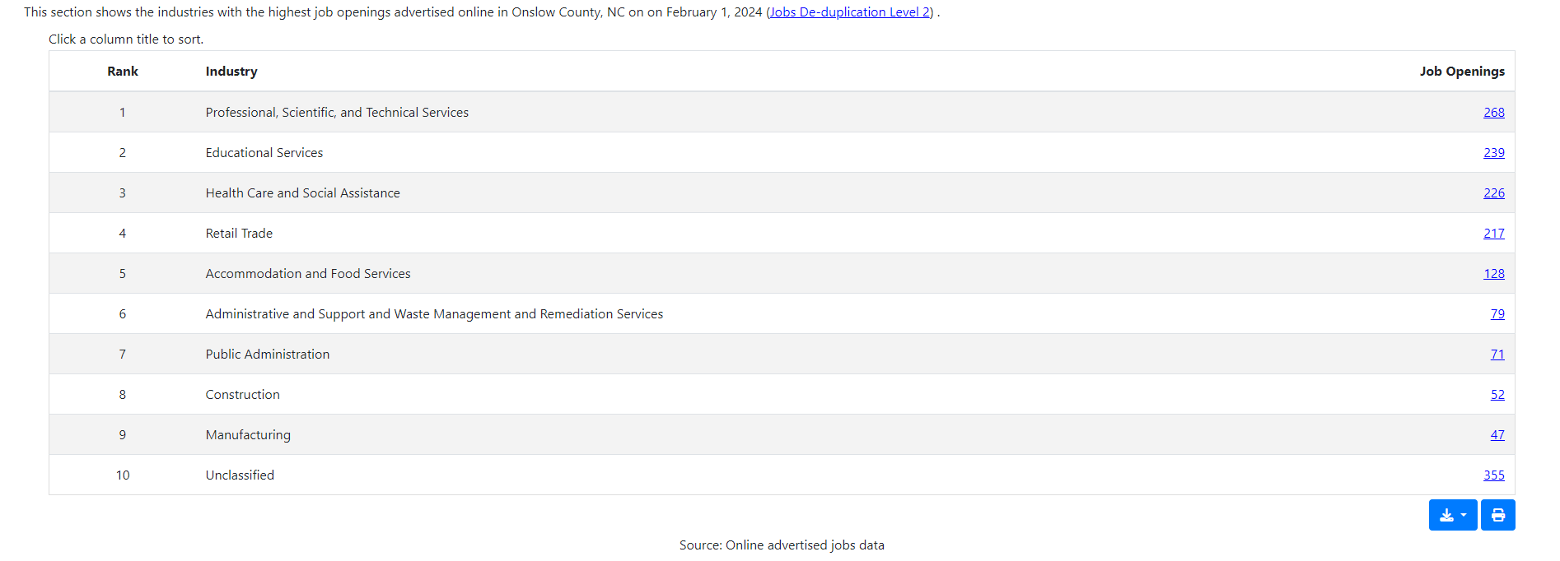
Onslow County Jobs Forecast
3

Slide 14
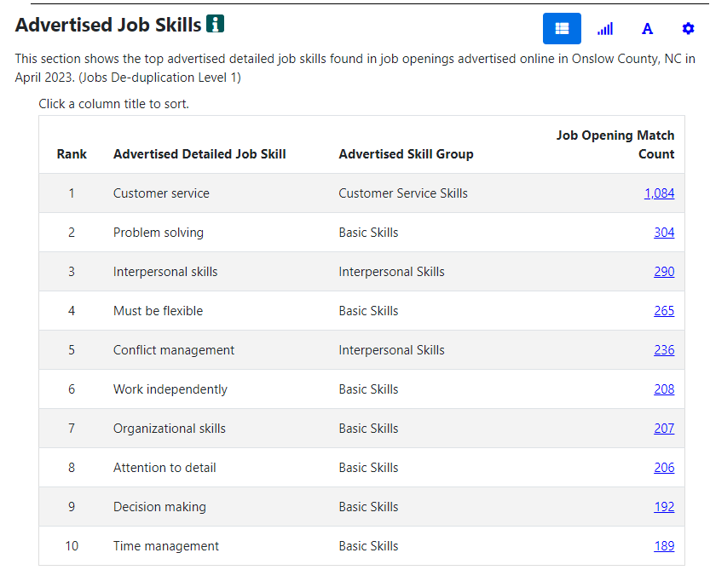
Onslow County Jobs Forecast
3

Slide 15
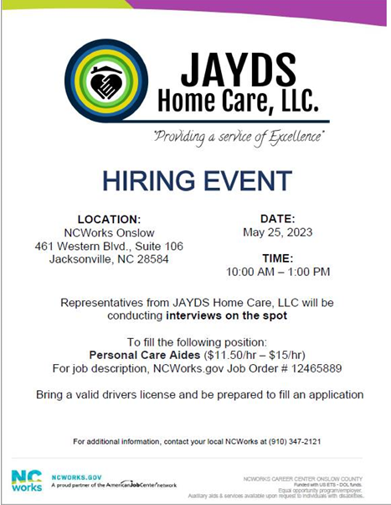
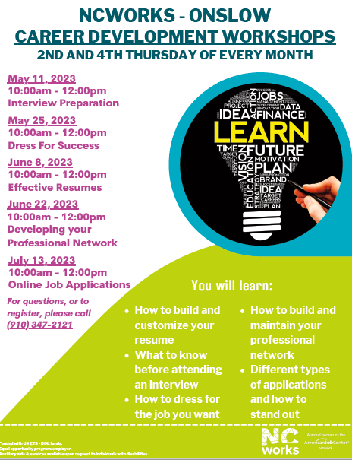

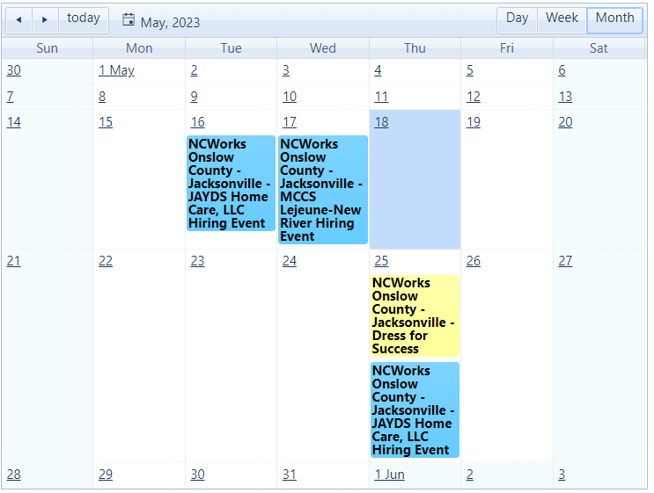

Slide 16

Questions?
THANK YOU!
Elizabeth Alexander
NCWorks Career Center
461 Western Blvd., Suite 106
Jacksonville, NC 28546
onslowcounty@ncworks.gov
910.347.2121
3

