Slide 1

Quad Chart Template
Revised March 2026

Slide 2
SCOUT CARD:
Capability Name
  Company Logo
  Name of Company
  POC: name/phone/email
Problem
Technology name, picture, and brief description:
Provide a concise overview of the evaluated technology.
What problem do you solve?
Focus on identifying the specific problem or challenge faced by the Warfighter (military personnel or units).
  Solution Specifics
  How do you solve the problem?
  Details of how the technology proposed in the quad chart addresses the identified problem.
  Why you? What makes you different from the competition?
  Unique Selling Proposition (USP)
Impact and Technical Approach
Technology Readiness Level (TRL): The TRL scale ranges from 1-9
Manufacturing Readiness Level (MRL): The MRL scale ranges from 1-10
What is the Impact of your Solution?
The potential impact of the proposed technology on addressing the identified problem.
What is the Technical Approach?
Methodology employed in developing the technology.
  Performance
  End-user payoff/expected operational value/new capability:
  Expected outcomes or benefits that end-users, typically the Warfighter, would gain from employing the proposed technology.
  Dual-Use (Commercial / Military) applications for the technology solution:
  Technology’s potential applications beyond the military domain in both commercial and military contexts.

Slide 3
Problem
Technology name, picture, and brief description: This section of the TIDE Tech Scouting Quad Chart provides a concise overview of the evaluated technology. It includes the name of the technology, a representative picture, and a brief description that highlights its key features and functionalities.
What Warfighter problem do you solve? This section focuses on identifying the specific problem or challenge faced by the Warfighter (military personnel or units). It outlines the context in which the technology is intended to be deployed and how it addresses a particular issue. The problem statement should clearly define the gap or need that the technology aims to fill, ensuring that it aligns with the requirements and objectives of the Warfighter.

Slide 4
Solution Specifics
How do you solve the problem? This section delves into the details of how the technology proposed in the quad chart addresses the identified problem. It describes the specific capabilities, features, or functionalities that make the technology a viable solution. It should highlight the technology's unique selling points or advantages and explain how it directly addresses the problem statement outlined in the previous section.
This section may also touch upon any key components, algorithms, methodologies, or approaches the technology employs to deliver its intended solution.
Why you, what makes you different from the competition?
Unique Selling Proposition (USP)
A unique selling proposition, or USP, is a tool salespeople use to communicate the key factors that separate your product from the competition. An effective USP communicates your brand's values and differentiates what your company offers through what you stand for and how this benefits your customers.
An effective USP communicates your brand’s values and differentiates what your company offers through what you stand for and how this benefits your customers. It’s used in the early stages of the sales process, and the guiding question for creating it is asking yourself, “What does my business offer that’s different from the competition?”

Slide 5
Impact and Technical Approach
Technology Readiness Level (TRL): This section uses the Technology Readiness Level scale to assess the technology’s maturity level. The TRL scale ranges from 1 to 9, with 1 indicating basic principles observed and 9 representing a fully operational technology deployed and proven in its intended environment. The TRL assigned to the technology indicates the level of technological development and readiness for deployment. It helps evaluate the feasibility and potential risks of implementing the technology within the desired context.
What is the Impact of your Solution? This subsection examines the potential impact of the proposed technology on addressing the identified problem. It explores the benefits and advantages that can be derived from successfully implementing the technology. The impact could include improvements in efficiency, effectiveness, cost reduction, enhanced capabilities, reduced risks, or any other positive outcomes that can be attributed to the technology. It also considers the broader implications and relevance of the technology within the target operational environment.
Technical Approach: This section outlines the technical approach or methodology employed in developing the technology. It overviews the key steps, processes, or methodologies used to design, build, and refine the solution. The technical approach may involve specific engineering principles, scientific methods, research and development practices, software development methodologies, or other relevant approaches used to create and advance the technology. This section highlights the technical expertise and innovation behind the solution.

Slide 6
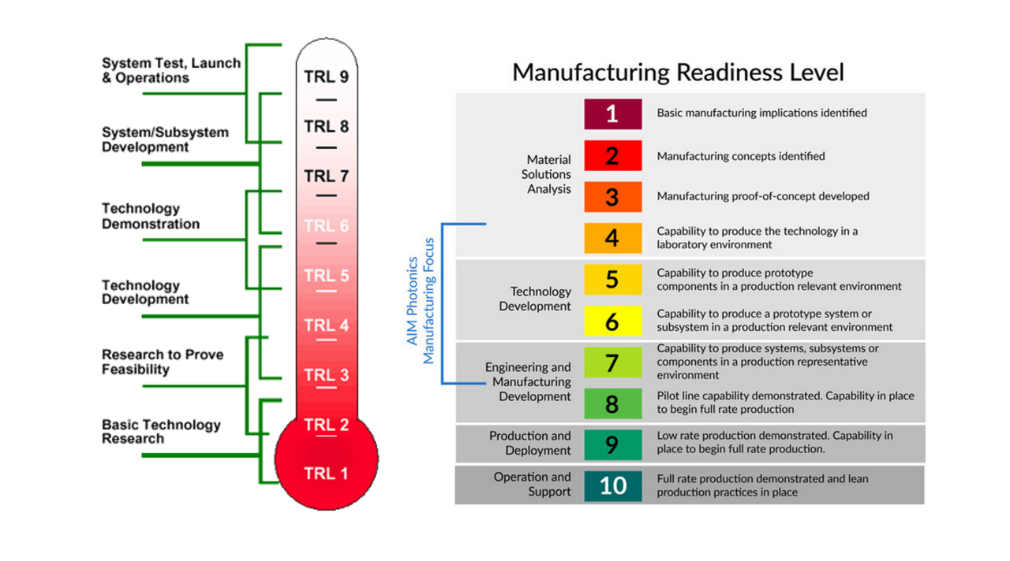

Slide 7
Performance
End-user payoff/expected operational value/new capability: This section highlights the expected outcomes or benefits that end-users, typically the Warfighter, would gain from employing the proposed technology. It outlines the value proposition of the technology and its potential to provide a significant advantage or new capability to the end-users. This could include increased operational effectiveness, improved situational awareness, enhanced decision-making capabilities, reduced workload, increased speed, or any other measurable and meaningful improvements the technology brings to the end-users.
Dual-Use (Commercial / Military) applications for the technology solution: This subsection explores the technology’s potential applications beyond the military domain in both commercial and military contexts. It investigates how the technology can be leveraged to address challenges or provide value in non-military sectors. The technology's potential for broader adoption, scalability, and commercialization can be assessed by identifying dual-use applications. This could involve exploring how the technology can be re-purposed, modified, or integrated into existing commercial systems or processes, extending its impact beyond the military domain.

