Slide 1
Navigating NAICS Codes, SAM.gov, and DSBS Profiles
Presented by: David James, Eastern Region GCAP Counselor
Notes:
Good morning/afternoon, everyone! Thank you for joining today’s session on navigating NAICS codes, SAM.gov registration, and DSBS profiles. My name is Pam Racer, and I’ll be guiding you through the process to help you understand these essential foundational tools for federal government contracting. Whether you're new to government contracting or looking to optimize your approach, we hope you gain valuable insights and practical guidance. Quick logistics reminder on the webinar we have GCAP counselors that can answer immediate questions in the chat.

Slide 2
Agenda
NAICS: Understanding & Selecting Industry Codes
SAM.gov: Registration
DSBS: Creating an Effective Profile
Live System Demonstrations
Q&A
Notes:
Here’s what we’ll cover today:
First, we’ll start with NAICS codes—why they matter, how they impact your business, and how to select the right ones.
Next, we’ll walk through SAM.gov registration, covering the steps required, best practices, and common pitfalls to avoid so you can streamline the process.
Finally, we’ll discuss the DSBS profile, an essential tool that helps government buyers and prime contractors find your business. I’ll share tips on optimizing your profile to increase visibility and attract contracting opportunities.
- Throughout our session, we’ll be using a sample company, TechServe Solutions, to demonstrate how these concepts apply in real-world scenarios.
- We’ll also have time for Q&A at the end, but if something isn’t clear as we go along, feel free to ask questions. My goal is to make sure you walk away with clarity and confidence in these processes.

Slide 3
NAICS Codes – Your First Step in Federal Contracting
✅ What is NAICS?
Federal classification system for business industries
Used in contracting, size standards, and economic data
Required for SAM.gov registration
✅ How It Impacts You
Determines set-aside eligibility (small business, 8(a), HUBZone, etc.)
Prime contractors & agencies search by NAICS to find businesses
Impacts whether you qualify as a small business under SBA rules
✅ Selecting the Right NAICS Code(s)
✔ Pick primary NAICS that best describes your business
✔ You can list multiple codes, but your primary should reflect core capabilities
✔ Check size standards at SBA.gov to see if you qualify as small
✔ Research similar businesses at census.gov/naics
🎯 Tip: Avoid listing too many NAICS codes—it can dilute your focus!
🔗 Resources: www.census.gov/naics | SBA Size Standards
Notes:
Before you can register in SAM.gov, you need to understand NAICS codes. NAICS, or the North American Industry Classification System, is the federal standard for classifying businesses. It’s not just a label—it impacts your eligibility for set-aside contracts, determines your business size status, and helps federal buyers find you.
Your primary NAICS code should reflect your core service or product. If your business covers multiple areas, you can list more than one, but be strategic—too many codes can make it unclear what your company truly specializes in. Research your options at census.gov/naics and always check SBA’s size standards to confirm if you qualify as a small business. Your NAICS selection can affect your competitiveness in federal contracting.
Remember, contracting officers and prime contractors search by NAICS codes—so choosing the right ones improves your visibility.
*******************************Longer script**********************
Let's start with NAICS codes. NAICS stands for North American Industry Classification System. It's a standardized system used to classify business establishments and is crucial for government contracting.
Why are NAICS codes important? They're used by federal agencies to identify specific industries and determine size standards for small businesses. When you register in SAM.gov, you'll need to select NAICS codes that represent your business activities.
Here are some key points about using NAICS codes:
You can select multiple codes, but you'll need to choose a primary one.
Your selection impacts your eligibility for set-aside contracts and determines the size standards that apply to your business.
It's crucial to research codes thoroughly. You can do this at census.gov/naics.
For complex businesses, it might be worth seeking professional advice to ensure you're selecting the most appropriate codes.
Let's look at our sample company, TechServe Solutions, to see how this works in practice.

Slide 4
SAM Registration
Notes:
Next, we’ll move on to the SAM.gov registration process, where these codes will be applied. Because this section will cover most of the presentation I will review questions at the next section.

Slide 5

What is SAM?
Definition: System for Award Management
What is it?: Central database for federal contracting
Who manages?: General Services Administration (GSA)
Why needed?: Required for federal contract/grants
What does it do?:
Platform for entity validation
Gateway to government opportunities
Enables electronic payment
Prerequisite for SBA certifications
Notes:
Before you can compete for federal contracts, you need to be registered in SAM.gov, which stands for the System for Award Management. This is the central database for all businesses looking to do business with the federal government.
So, what exactly is SAM.gov? It is managed by the General Services Administration (GSA) and serves as the primary platform for government contracting eligibility. If your business is not registered here, you cannot bid on contracts, receive federal grants, or even get paid by the government.
Let’s break down why SAM.gov is essential:
✅ It validates your business entity – ensuring your company exists and meets federal requirements.
✅ It acts as a gateway – allowing agencies and prime contractors to find small businesses like yours.
✅ It enables electronic payments – required for all government transactions.
✅ It’s a prerequisite for SBA certifications – such as 8(a), HUBZone, and WOSB programs.*
To register, you’ll first need a Login.gov account, and from there, you’ll complete the entity validation process. We’ll go through that step-by-step in the next section

Slide 6

Step 1. Set up your login.gov Account for SAM registration
Create a Login.gov Account
Business email address (one you check regularly)
Password (meeting security requirements of 12 characters long)
Two-factor authentication (2FA) setup
  Phone number or
  Authentication app
Use your login.gov ID and password
Login to sam.gov and create an account.
Notes:
Before you can start your SAM.gov registration, you need to create a Login.gov account. This is required because SAM.gov no longer allows direct logins – all users must authenticate through Login.gov for added security.
To create your Login.gov account, follow these steps:
✔ Use a business email – This should be an email you check regularly, as it will be used for all official government notifications.
✔ Set a secure password – Login.gov requires a 12-character password, so make sure it meets security standards.
✔ Enable Two-Factor Authentication (2FA) – You’ll need to verify your identity with either a phone number or an authentication app.
✔ Use your Login.gov credentials to access SAM.gov and begin the registration process.
A quick note – it’s better to use a business email rather than a personal one. Government agencies may contact you through this email, so using a company domain ensures professionalism and prevents issues later in the process.
Once your Login.gov account is set up, you’ll be ready for the next step: Entity Validation & Unique Entity ID (UEI) Registration in SAM.gov.

Slide 7
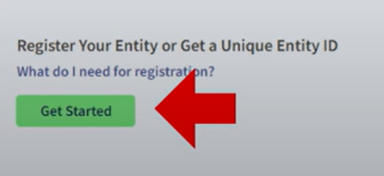
Step 2: Obtain a Unique Entity ID (UEI)
Go to SAM.gov and select “Sign in” then Get Started with registration in Workspace
Provide your organization's legal business name and physical address
Acceptable documents to provide existence of company
Entity Validation Document Requirements
Takes 1-3 business days to validate for a UEI
Claim your UEI (usually provided immediately if business is found, but may take 1-3 business days if additional verification is needed)
Tip: Ensure your business name and address match exactly with IRS & Secretary of State records to avoid validation delays!
Notes:
Once you’ve set up your Login.gov account, the next step in registering for SAM.gov is obtaining your Unique Entity ID (UEI). This is a required identifier that replaces the old DUNS number and is used to verify your business in federal systems.
To get your UEI, follow these steps:
✔ Log into SAM.gov it will ask you for your name and information to create an account on sam.gov. This only means you can login to sam.gov nothing else.
✔ Once you have created an account it will take you to your workspace and that is where you will find the Get Started section. That I will show you soon.
✔ Enter your business's legal name and physical address exactly as it appears on IRS & state records.
✔ Provide required documentation to validate your entity (check the Acceptable Documents link for details).
✔ Wait for validation – in some cases, UEI is generated immediately, but if verification is needed, it may take 1-3 business days.
A common mistake that causes delays is an address mismatch. Ensure that the business name and physical address you enter match what’s listed on your IRS filings, business registration, and bank records.
Registering your company to receive a UEI (This only validates you exist, will not allow you to bid on contracts or get paid for services). This is all free and you don’t have to pay anyone to do this.
Once your UEI is issued, you’re ready for the next step: Completing the SAM.gov Registration Process.
I will be showing an example at the end of this section using our sample company.
**********************NOTES************
The acceptable documents must meet all 4 requirements
Legal business name and physical address in the same document
Legal business name and doing business as name in the same document
Legal business name and US state of incorporation in the same document
Legal business name and start year in the same document
Documents can include:
Most Commonly Used Documents: ● Articles of Incorporation/Organization/Formation (if stamped as filed with an authority) ● Bank Statements* (redact information that isnt necessary for validation) ● Certificate of Formation/Organization (if stamped as filed with an authority) ● Department of Treasury IRS letter assigning your EIN ● Secretary of State Certificate of Filing ● Screenshot/PDF file of your business profile* in your states online business registry or Secretary of State website (must be current registration and must include the registry URL) ● Utility Bill* (water, gas, or electric only)

Slide 8
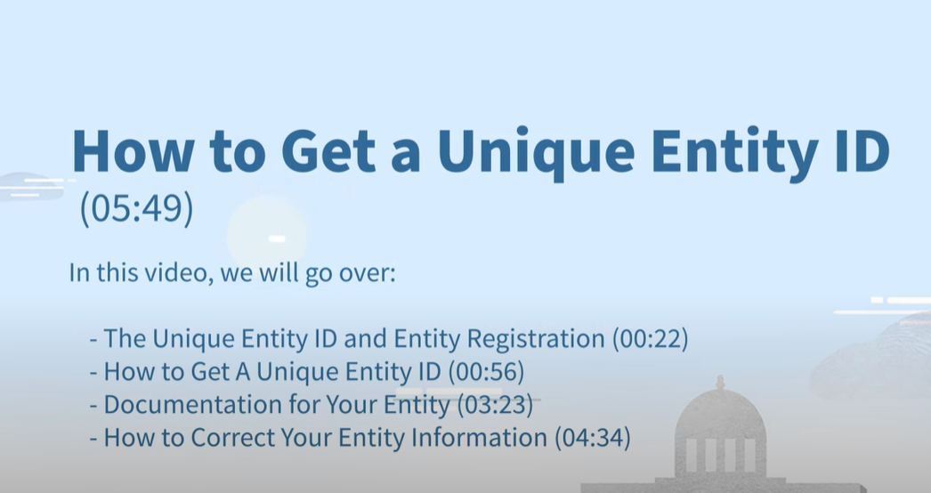
Step 2: Resources
What do you need to get a Unique Entity ID?
Legal Business Name
Physical Address (no PO Boxes)
Start year or Year of Incorporation
State Incorporation
Step by Step videos
https://youtu.be/my9eIQheQDw?si=EJdfGnKKFf9U3hE9
https://youtu.be/4RSHjczdxq8?si=rOGF7crsWQcr93Hr
https://youtu.be/my9eIQheQDw?si=VEzLvPy-CL0vOx3T
Validation Assistance Instructions
https://youtu.be/56NQ77JX5yo?si=mkhayDjtz1ryRZ1x
Knowledge Base Instructions
https://www.fsd.gov/gsafsd_sp?id=kb_article_view&sysparm_article=KB0038643
Notes:
So to reiterate, these are the things you need on hand to get your UEI.
You’ll need:
Your Legal Business Name—make sure it matches exactly how it's registered.
A Physical Address—no PO boxes allowed.
The Year Your Business Started or Incorporated—this helps with validation.
Your State of Incorporation, if applicable.
To make the registration process easier, the General Services Administration (GSA) has created a series of step-by-step videos to guide you through entity registration, validation, and troubleshooting.
On the right side of this slide, you’ll see links to:
Step-by-step registration videos. They are narrated by the GSA with clear instructions that you can use while completing you registration. The first link is the newest video
Guidance on entity validation—if there are any issues verifying your business.
I highly recommend watching these videos beforehand so you know what to expect. Now, let’s move forward and walk through the next steps in SAM registration!

Slide 9
Step 3: Cage Code Assignment
Gather necessary information before starting:
Unique Entity ID (UEI) must be issued first
Tax Identification Number EIN/SSN
CAGE Code (if applicable, usually means older lapsed registration)
Selected NAICS codes
Company Banking Information
Point of Contacts for the Company
  Accounting – Who do you want the government to contact about payments or invoices?
  Electronic – Who do you want the government to contact about your sam.gov account?
  Government – Who do you want the government to contact about bidding, proposals or negotiations?
Start entity registration
  Complete core data (including NAICS codes)
  Assertions
  Representations and Certifications
  Points of Contact
Submit registration and wait for approval (Estimated time at least 10 days)
International equivalent is NGAGE
Tip: Cage Codes are issued only after UEI validation!
Notes:
Now that we have the UEI, we move to the final step: CAGE Code Request. The CAGE Code (Commercial and Government Entity Code) is a unique identifier assigned to all federal contractors.
Here’s what you’ll need to complete this step they must be on hand or the system will time out and make you start all over:
✔ Unique Entity ID (UEI) – Assigned in the previous step.
✔ Tax Identification Number (EIN/SSN) – Must match IRS records.
✔ Company Banking Information – Required for electronic payments.
✔ Selected NAICS Codes – Ensures you’re classified correctly in government databases.
✔ Points of Contact (POC):
Accounting – Who should receive payment inquiries?
Electronic – Who manages the SAM.gov account?
Government – Who handles bids, proposals, and negotiations?
Once you have this information ready, you’ll complete your SAM.gov entity registration by filling in:
Core business data (including NAICS codes).
Assertions (confirming business structure & ownership details).
Representations & Certifications (eligibility for set-aside contracts).
Points of Contact (ensuring agencies can reach you).
After submitting your registration, approval typically takes at least 10 business days. If additional validation is needed, it could take longer.
A key point: CAGE Codes are automatically assigned when your SAM registration is approved—there is no separate application process.
For international vendors, the equivalent to a CAGE Code is called NCAGE (NATO Commercial and Government Entity Code) and follows a slightly different process.
Once your registration is approved, you’re officially in the federal contracting system!

Slide 10
Step 3: Resources
Entity Registration Checklist
https://www.fsd.gov/sys_attachment.do?sys_id=82f480491b4dfd142fe5ed7ae54bcb0c
Preparing for Registration
https://www.fsd.gov/gsafsd_sp?id=kb_article_view&sysparm_article=KB0016844
Purpose of Registration
https://youtu.be/PcglzVqx8c8?si=GSaY2K2o3FPEfESf
Workspace Navigation
https://youtu.be/QL7YzxvBP9g?si=Hr_a65vQyIOahkPs
Notes:
Now that we've covered Steps in the SAM registration process, I want to highlight some key resources that will help you navigate this step more efficiently.
First, on the left side of this slide, we have links to:
The Entity Registration Checklist, which provides a detailed guide on what you need before starting registration.
A Preparing for Registration guide that outlines important pre-registration steps to ensure a smoother process.
On the right side, we have additional video resources:
A short video on the Purpose of Registration, which explains why SAM registration is necessary and how it impacts government contracting.
A walkthrough on Workspace Navigation, guiding you on how to use your SAM.gov account effectively once registered.
I highly recommend bookmarking these resources and reviewing them as needed.

Slide 11

Avoid These Common SAM Registration Mistakes!
Mistake: Incomplete or incorrect information (address mismatch, missing data)
  Fix: Ensure business name and address match IRS and Secretary of State
Not updating or renewing your registration annually.
  Fix: Set a calendar reminder one month before expiration
Failing to list correct NAICS codes.
Need Help? Check the SAM.gov Help Desk: www.fsd.gov
Notes:
Even a small mistake in your SAM registration can lead to major delays. Let’s go over the most common pitfalls and how to avoid them.
Mistake #1: Incomplete or Incorrect Business Information
One of the most frequent errors is entering a business name or address that doesn’t match IRS, Secretary of State, or bank records. If your details don’t align, your entity validation could be delayed for weeks.
Fix: Double-check your legal business name and address against your tax documents before submitting your registration.
Mistake #2: Not Updating Your SAM Registration Annually
SAM registrations expire every 12 months. If you don’t renew it, your business will be ineligible for contract awards until it’s reactivated.
Fix: Set a reminder one month before expiration to update your registration and avoid deactivation.
Mistake #3: Selecting Incorrect NAICS Codes
Choosing the wrong NAICS code can limit your eligibility for set-aside contracts or prevent agencies from finding your business in searches.
🔹 Fix: Carefully research and select NAICS codes that match your core services, not just general industry categories.

Slide 12
Live Demonstration: SAM website
📌 Step 1: Accessing SAM.gov
🔗 www.sam.gov
📌 Step 2: Using Registration Resources
  Registration videos with step by step
  Entity Registration videos
  Entity Validation video
📌 Step 3: Getting Help & Troubleshooting
🔗 Federal Service Desk (FSD)
Notes:
1️⃣ Introduction to the SAM.gov Dashboard
SCRIPT :Before we dive into the registration process, let’s take a moment to explore the SAM.gov dashboard. This is where you'll manage your registration, search for contract opportunities, and check your entity status.
DEMONSTRATE:
🔹 Key Areas to Highlight:
✔ Sign-In Process – Show how to log in via Login.gov.
✔ Dashboard Overview – Explain where to find entity registration, active registrations, and updates.
✔ Search Bar – Show how to look up registered entities, contract opportunities, or exclusions.
Tip: Even without a registered company, you can demonstrate how to use the search function to find other registered businesses or NAICS codes.
2️⃣ Walkthrough: The Registration Process (Up to Your Limit)
Script:If you're registering for the first time, you’ll need to go to the “Get Started” section. Let’s go step by step through what you’ll see when registering an entity. We have requested for years for GSA to allow a sample account so we can train companies and they have not allowed those. Instead they ask you to refer to their vides.
DEMONSTRATE🔹 What You Can Show Live:
✔ Click “Get Started” and show the initial prompts.
✔ Walk through the steps of entity registration up to where you're blocked.
✔ Explain what happens next beyond your access.
3️⃣ Exploring Registration Support Resources
Script: Since many users encounter issues with entity validation or registration delays, SAM.gov offers a variety of support resources to help businesses navigate the process. Let’s explore those now.
DEMONSTRATE:🔹 Key Support Features to Highlight:
✔ Help Section & FAQs – Walk through the FSD (Federal Service Desk) knowledge base.
✔ Registration Videos – Show how to access step-by-step tutorials.
✔ Entity Validation Help – Explain where to find the list of acceptable documents.
Tip: Show the FSD troubleshooting section and explain how to submit a ticket if users run into problems.
I hope this gives you an idea of what to expect. If you run into issues, I highly recommend using the Federal Service Desk (FSD) knowledge base or submitting a ticket if needed. Next, we’ll discuss optimizing your DSBS profile to attract contracting opportunities.

Slide 13

SAM Support
Before Requesting Assistance
✅ Obtain your Unique Entity ID (UEI)
✅ Attempt Entity Registration on SAM.gov
✅ Use GSA’s step-by-step resources
✅ Ensure government contracting aligns with your business goals
✅ Understand SAM.gov is a tool, not a contract-winning strategy
Sam.gov by the Numbers
  2.8+ million registered users
  768,000+ active registered entities (70% All Awards)
  24,000+ new opportunities/notices posted per month
Notes:
Before we get into support requests, let’s talk about a few key steps you should take before reaching out for assistance with SAM.gov registration. We want to ensure that your time—and ours—is used effectively, and that you’re setting yourself up for success in federal contracting.
✅ First, make sure you have obtained your Unique Entity ID (UEI). This is your first step before you can even begin the registration process.
✅ Next, attempt your entity registration on SAM.gov. Even if you don’t complete it, starting the process will help you identify any questions or issues that may arise.
✅ GSA has created detailed step-by-step resources to guide you through the process, including videos and instructions—so take advantage of those first.
✅ Most importantly, ensure that government contracting truly aligns with your business goals before registering. Just because you can register doesn’t mean you should if you’re not ready for this space.
✅ Finally, remember—SAM.gov is a tool. It is not a contract-winning strategy. Being registered is simply the first step—it does not guarantee you will win awards.
(Transition into SAM.gov by the Numbers)
Now, why do we emphasize this?
At our annual event in DC, GSA’s lead program manager shared this: 80% of businesses in SAM.gov have never won a prime award.
(80% statistic appears on screen)
Out of 768,000 active entities, about 70% are there for contracting. That’s over 500,000 businesses competing for work yearly—yet only around 108,000 have won a prime contract.
The key takeaway? SAM.gov is a tool, not a guarantee. It’s a license to fish—nothing more.

Slide 14
Your Post-Registration Action Plan
1️⃣ Set a Renewal Reminder (Keep it at 11 months)
SAM.gov registrations must be updated every year to stay active.
Set a calendar reminder at the 11-month mark so you don’t risk deactivation.
2️⃣ Monitor Contract Opportunities
Use SAM.gov to track relevant solicitations & federal spending trends.
Set up contract alerts to receive notifications for new opportunities.
3️⃣ Build a Strong Government Contracting Strategy
Enhance your DSBS profile to increase visibility with contracting officers.
Develop a capability statement to market your business effectively.
Consider small business certifications (e.g., 8(a), WOSB, HUBZone) if eligible.
Notes:
Now that you’ve completed your SAM.gov registration, what’s next? Registration alone doesn’t bring in contracts—it’s just the first step. To maximize your opportunities, you need a post-registration action plan to stay competitive and position your business for success. Let’s walk through the key actions you should take after registering.
✔ First, Set a Renewal Reminder – SAM.gov requires annual updates. If you let your registration lapse, you become ineligible for federal contracts. Set a calendar reminder at the 11-month mark so you don’t miss your renewal.
✔ Second, Monitor Contract Opportunities – Registration is just the first step. Now, you need to start identifying federal contract opportunities that align with your business. Set up alerts in SAM.gov to stay informed about upcoming bids.
✔ Third, Strengthen Your Contracting Strategy – Federal buyers look for complete and well-optimized profiles. Take the time to refine your DSBS profile, develop a capability statement, and explore potential small business certifications that can give you a competitive edge.
Speaking of DSBS

Slide 15
Dynamic Small Business Search (DSBS)
Notes:
DSBS is the last screen of your registration based on your size determinations before you hit the submit button on your entity registration. It used to allow you to directly connect from sam.gov but now you have to use another method. Let’s talk about that.

Slide 16
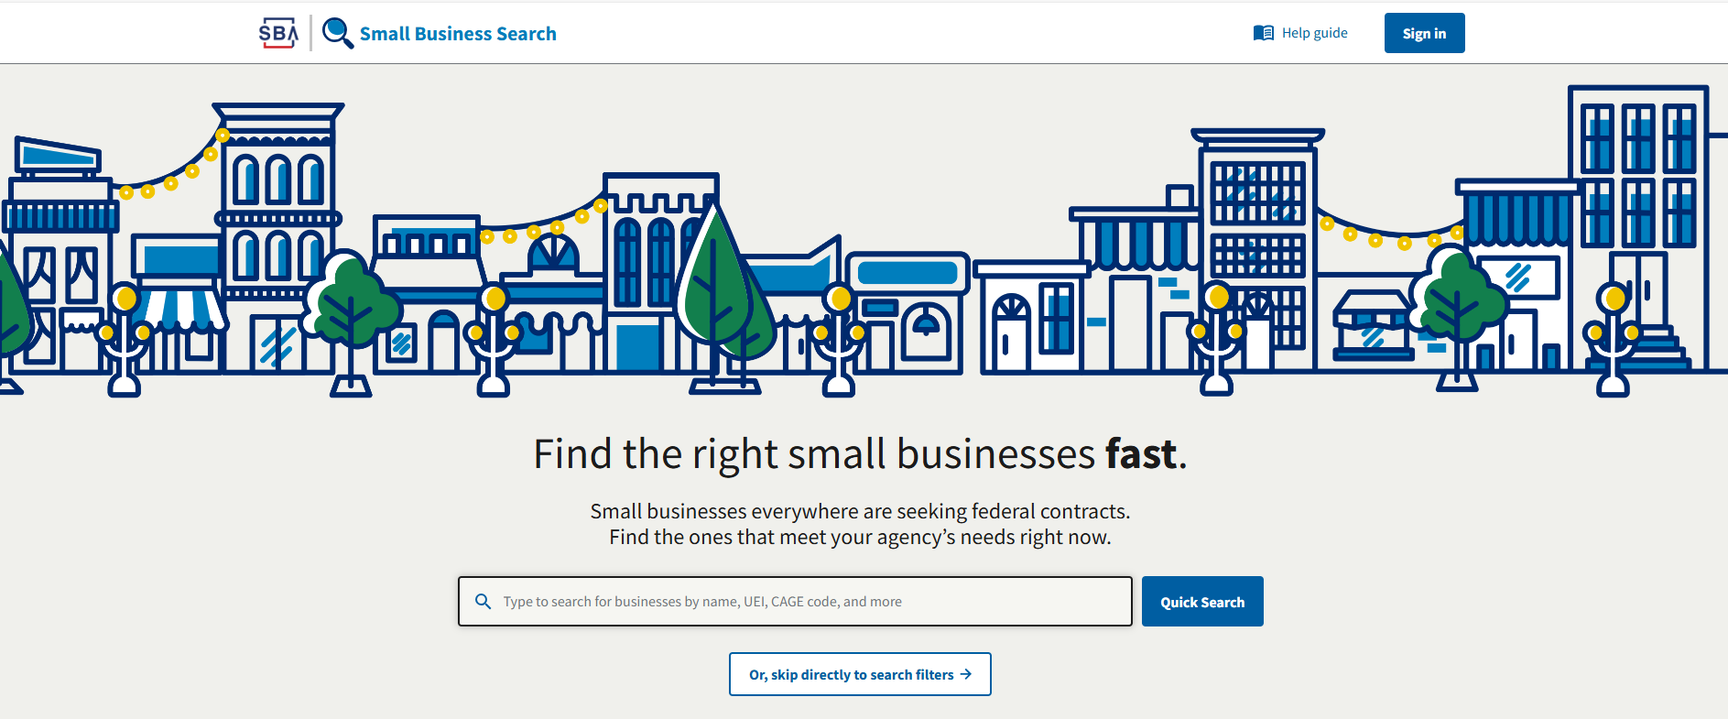
DSBS: The Key to Being Found by Federal Buyers
What is it?
Dynamic Small Business Search database
Managed by the Small Business Administration (SBA)
Who uses it?
Used by contracting officers and prime contractors
How do they use it?
Government buyers and prime contractors search DSBS to find small businesses that meet their requirements.
An incomplete or poorly written DSBS profile can result in missed opportunities.
Notes:
🔹 What is DSBS?
DSBS is a federal database managed by the Small Business Administration (SBA). When you complete your SAM.gov registration, your business is automatically added to this database. However, the default profile is basic and incomplete—so if you don’t optimize it, contracting officers won’t find you.
🔹 Who Uses DSBS?
✔ Contracting officers – Searching for small businesses to meet set-aside requirements.
✔ Prime contractors – Looking for small business subcontractors.
🔹 How is DSBS Used?
Government buyers search for businesses using NAICS codes, keywords, past performance, and certifications. If your profile lacks details or keywords, you won’t show up in searches, meaning missed opportunities.
Key Takeaway:
If your DSBS profile isn’t complete and keyword-optimized, you might as well be invisible to government buyers. In the next slides, we’ll cover how to optimize your profile so you stand out and get noticed for contract opportunities.

Slide 17
Key Elements of a DSBS Profile
📌 What’s Already in DSBS (Auto-Populated from SAM.gov): Company name, address, NAICS, certifications and contact details.
📌 What You Must Optimize & Control:
Keywords (for searchability)
Capability Narrative (Your pitch)
Past Performance & Certifications (builds credibility)
Bonding/Insurance levels
Quality certifications
Character Limits & Formatting:
Capability narrative: 2,000 characters
Keyword field: 255 characters
Use clear paragraphs in narrative sections
Include bullet points for easy scanning
Avoid all caps except for acronyms
Search Optimization:
Contracting officers often search by:
  NAICS codes + location
  Specific certifications + capabilities
  Past performance in similar work
  Geographic radius from project location
Notes:
Now that we understand what DSBS is, let’s break down the key elements that make up your profile and how to optimize them so that contracting officers can actually find and contact you.
🔹 What’s Already in DSBS (Auto-Populated from SAM.gov)
When you complete your SAM.gov registration, certain basic information is automatically pulled into your DSBS profile, including:
✔ Company Name & Address
✔ NAICS Codes
✔ Contact Details
However, this is just the bare minimum—if you stop here, you won’t stand out.
🔹 What You Must Optimize & Control
There are several key areas in DSBS that you have control over and should take time to improve:
✔ Keywords (For Searchability) – Think about what government buyers type in when looking for businesses like yours.
✔ Capability Narrative (Your Pitch) – This is your elevator pitch, explaining what your company does and how you stand out.
✔ Past Performance & Certifications – Highlight previous government or commercial projects that demonstrate credibility.
✔ Bonding & Insurance Levels – Especially important for construction and service contracts.
✔ Quality Certifications – If you have ISO, CMMC, or other industry-specific credentials, include them!
The more detailed and well-crafted this information is, the better your chances of showing up in search results and winning contracts.
🔹 Character Limits & Formatting Guidelines
Now, let’s talk about how to format your profile to make sure it’s readable and effective:
✔ Capability Narrative: 2500-character limit—keep it clear and compelling.
✔ Keyword Field: 525-character limit—use concise, industry-relevant terms.
✔ Use clear paragraphs – Break text into sections so it’s easy to skim.
✔ Include bullet points – This makes important information stand out. But remember everything is counted as a character so keep that in mind.
✔ Avoid ALL CAPS (except for acronyms) – Government buyers scan profiles quickly, and large blocks of capitalized text can be difficult to read.
A well-structured profile increases your chances of being noticed and contacted by procurement officers.
🔹 How Contracting Officers Search in DSBS
Federal buyers don’t just randomly scroll through DSBS—they search strategically using key filters and criteria. Here’s what they’re looking for:
✔ NAICS Codes + Location – They often filter by industry and geographic region to find local vendors.
✔ Specific Certifications + Capabilities – If they need a set-aside business (e.g., WOSB, HUBZone), they will filter by certification.
✔ Past Performance in Similar Work – Having examples of past government projects increases credibility.
✔ Geographic Radius from Project Location – Many buyers look for businesses within a certain mile radius of where the contract work will take place.
By optimizing your keywords, capability narrative, and past performance, and structuring your content properly, you increase your visibility and improve your chances of securing contracts. In the next section, we’ll go even deeper into how to optimize your DSBS profile for maximum impact.

Slide 18
Live Demonstration: DSBS
Access DSBS & SBA Systems
  🔗 web.sba.gov – Landing page for SBA tools related to DSBS & small business programs.
Manage Your Profile in Pro-Net
  🔗 connect.sba.gov – Where you can edit & update your DSBS profile.
Search for Your Business & Competitors
  🔗 dsbs.sba.gov – The database where contracting officers search for small businesses.
If you don’t see your business in DSBS or it’s missing key details, check your SAM.gov registration and update your profile through Pro-Net.
Notes:
Script: Before we explore managing your profile, let’s take a quick look at how DSBS works.
Demonstrate:
🔹 Key Areas to Highlight:
✔ Accessing DSBS – Show how to navigate to dsbs.sba.gov.
✔ Search Functionality – Demonstrate how to look up businesses by NAICS codes, keywords, or location.
✔ How Contracting Officers Use DSBS – Highlight the filters and search criteria used to find businesses.
📌 Tip: Even without a registered company, you can demonstrate how to use the search function to view publicly available business listings.
Script:
"If you have an active SAM.gov registration, you can manage and optimize your DSBS profile through Pro-Net. Let’s walk through where to go and what to update.“
Script:
"If you have an active SAM.gov registration, you can manage and optimize your DSBS profile through Pro-Net. Let’s walk through where to go and what to update."
Demonstrate:
🔹 Key Steps to Managing Your Profile
✔ Go to connect.sba.gov – This is where you update your DSBS profile.
✔ Review Your Capability Narrative – Explain the importance of strong keywords and a clear business description.
✔ Update Certifications & Keywords – Show where small businesses can add NAICS codes, bonding levels, and differentiators.
✔ Verify Contact Information – Ensure that the listed email, phone number, and POC are correct.
Tip: If a business isn’t appearing in DSBS, they should double-check their SAM.gov registration and ensure it is marked as public.
Script:
"If you have an active SAM.gov registration, you can manage and optimize your DSBS profile through Pro-Net. Let’s walk through where to go and what to update."
Demonstrate:
🔹 Key Steps to Managing Your Profile
✔ Go to connect.sba.gov – This is where you update your DSBS profile.
✔ Review Your Capability Narrative – Explain the importance of strong keywords and a clear business description.
✔ Update Certifications & Keywords – Show where small businesses can add NAICS codes, bonding levels, and differentiators.
✔ Verify Contact Information – Ensure that the listed email, phone number, and POC are correct.
Tip: If a business isn’t appearing in DSBS, they should double-check their SAM.gov registration and ensure it is marked as public.

Slide 19
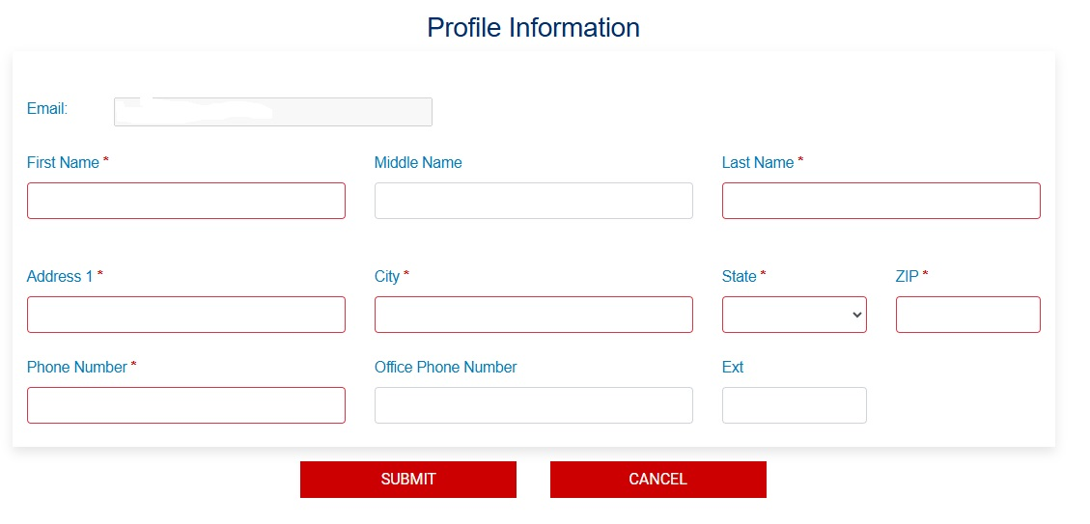
DSBS Resources
Step by step process
https://www.youtube.com/watch?v=zO6haU-xOVg
FAQs
https://connect.sba.gov/Home/FAQS
Notes:
As with SAM.gov, the DSBS platform has a step-by-step video to guide you through the process of claiming and updating your profile. It also includes an FAQ section for any questions you may have.
Your DSBS profile is more than just a formality—it’s a critical part of your government contracting strategy and it’s free to have and update. This is where contracting officers and prime contractors search for small businesses like yours, so it’s important to ensure your profile accurately represents your capabilities and competitive strengths.
I encourage you to spend time getting to know DSBS, exploring its features, and making updates as needed. The more familiar you are with it, the better positioned you’ll be to attract opportunities.

Slide 20
Optimize DSBS Profile
Keyword Strategy:
Use both industry-standard terms and government terminology
Include common abbreviations (e.g., IT and Information Technology)
Think like a contracting officer - what terms would they search?
Place most important keywords early in descriptions
Use variations (e.g., cybersecurity, cyber security, cyber-security)
Common DSBS Mistakes to Avoid🚫
Weak Capability Narrative – Too vague, lacks details
No Keywords – Won’t show up in search results
Missing Past Performance – Even commercial projects count
Personal Email – Use a business email (e.g., govbiz@company.com)
Not Updating Regularly – Refresh at least quarterly
Notes:
Now that you understand the key elements of a DSBS profile and how buyers search for businesses, let’s talk about how to optimize your profile so that you stand out and actually get noticed.
🔹 Keyword Strategy: How to Be Found in DSBS Searches
One of the biggest mistakes businesses make is not using the right keywords in their DSBS profile. Contracting officers and prime contractors use keyword searches to find businesses, so your profile must include both industry-specific and government terminology.
✔ Use both industry-standard terms and government terminology
For example, IT services could be written as “Software Development” but also include “Custom Application Development”, which is a term often used in federal contracts.
✔ Include common abbreviations (e.g., IT & Information Technology, HVAC & Heating, Ventilation, and Air Conditioning)
Think about how someone might type in different variations of your service.
✔ Think like a contracting officer—what would they search for?
If you’re in construction, would they search for “general contractor” or “commercial construction services”?
✔ Place the most important keywords early in descriptions
The first few words in your capability narrative and keyword section have the most weight in search results.
✔ Use variations of terms (e.g., cybersecurity, cyber security, cyber-security)
Different agencies may spell words differently, and you want to appear in all relevant searches.
🔹 Common DSBS Mistakes to Avoid
Many businesses unknowingly reduce their chances of being found because of these common mistakes:
Weak Capability Narrative – Too vague, lacks details.
Instead of saying “We offer IT services”, say “We specialize in cloud migration, cybersecurity solutions, and software development for federal agencies”.
No Keywords – Won’t show up in search results.
If your profile lacks relevant keywords, buyers can’t find you—so be strategic.
Missing Past Performance – Even commercial projects count.
Even if you don’t have government experience, listing corporate contracts, nonprofit work, or subcontracting experience helps establish credibility.
Using a Personal Email – Use a business email (e.g., govbiz@company.com).
A professional email makes your business look more credible to contracting officers.
Not Updating Regularly – Refresh at least quarterly.
If you haven’t updated your profile in over a year, it looks like you’re not actively pursuing government contracts.
🎤 Closing Thought:
If you take one thing away from this section, it’s this—your DSBS profile is only as strong as the details you include. A well-optimized profile with the right keywords, a compelling capability narrative, and complete past performance dramatically increases your chances of being found and contacted for government contracts.

Slide 21

Next Steps
Notes:
We’ve covered a lot today—understanding NAICS codes, navigating SAM.gov, optimizing DSBS, and the essential steps to position your business for government contracting success. Now, as we wrap up, let’s talk about what comes next and how you can take actionable steps to keep moving forward.

Slide 22
Your Path Forward
🚀 Step 1: Maintain Your SAM.gov Registration
Research and select codes that reflect your capabilities
Review codes annually as your business evolves
Understand how size standards impact contract eligibility
Update your Sam.gov profile annually and ensure POC information is correct.
🔍 Step 2: Optimize Your DSBS Profile & Certifications
Update certifications as you obtain them (e.g., WOSB, HUBZone).
Refresh your capability narrative & keywords quarterly to reflect changes.
Write from a contracting officer’s perspective—what would they look for?
📅 Step 3: Stay Proactive & Monitor Opportunities
Mark your calendar for SAM.gov renewal at the 11-month mark.
Regularly check for contract opportunities in SAM.gov & DSBS.
Government contracting success doesn’t happen overnight. Consistency, regular updates, and proactive engagement are key to winning contracts.
Notes:
We’ve covered a lot today, and now I want to help you turn this knowledge into actionable next steps so you can move forward with confidence in government contracting.
Step 1: Maintain Your SAM.gov Registration
First, make sure your NAICS codes truly reflect your capabilities. A mismatch could mean missing opportunities or competing in the wrong categories. Also, check the size standards—some contracts are set aside based on business size.
Your SAM.gov profile needs to be updated at least once a year—but don’t wait until the last minute. Keep your point of contact (POC) information business-focused and current so buyers can easily reach you.
Step 2: Optimize Your DSBS Profile & Certifications
Your DSBS profile is what makes you visible to contracting officers. Ensure your capability narrative is compelling, use the right keywords, and update it at least quarterly.
If you obtain new certifications (like WOSB or HUBZone), update them immediately in DSBS. These can impact your eligibility for set-aside contracts.
Step 3: Stay Proactive & Monitor Opportunities
Winning government contracts isn’t just about being registered—it’s about actively searching for opportunities. Set calendar reminders for:
✔ SAM.gov renewal (at the 11-month mark)
✔ Checking for new contract opportunities in SAM.gov & DSBS
✔ Revisiting your profile every quarter to keep it updated
If you update your profile regularly, monitor opportunities, and refine your keywords, you’ll be in a much stronger position to win federal contracts.

Slide 23

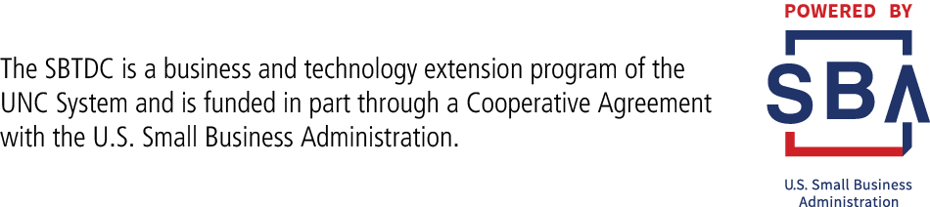
Questions?
Please go to https://forms.gle/b7pVFa23ccDgrsMS9
to complete survey
Please complete the survey to be sent the following:
Slides
Update on upcoming events
Presenter:
Visit www.sbtdc.org
Notes:
That wraps up our presentation, but we’re not done yet! We have time for an Ask Me Anything session, where you can ask any questions you have—whether they’re about today’s topics or anything related to government contracting.
How to Ask Your Questions:
Drop your question in the Q&A box, and I’ll address them one by one.
Raise your hand virtually, and I’ll unmute you so you can ask your question live.
Before we dive in, I have one quick request:
Please take a moment to complete our survey which I’ve put in the chat. Your feedback helps us improve these sessions or to add additional sessions and ensures you receive:
✔ A copy of today’s slides
✔ Updates on upcoming events and resources
Need more information later?
On the screen is my contact information.
Now, let’s get into your questions! Who wants to go first?

