Slide 1
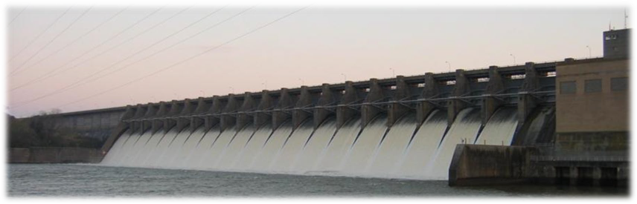
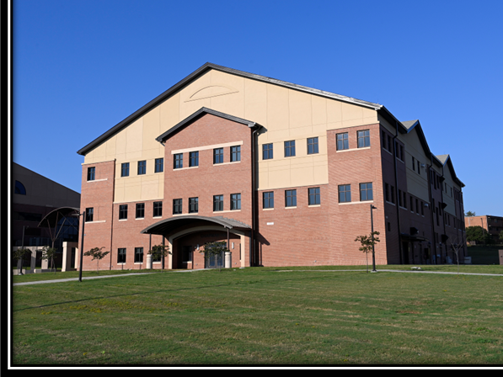
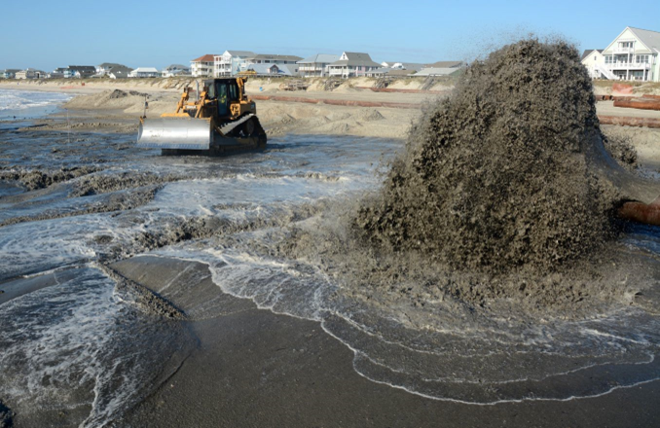
DOING BUSINESS
WITH usace
WILMINGTON district
FY25 + Program Overview

Slide 2
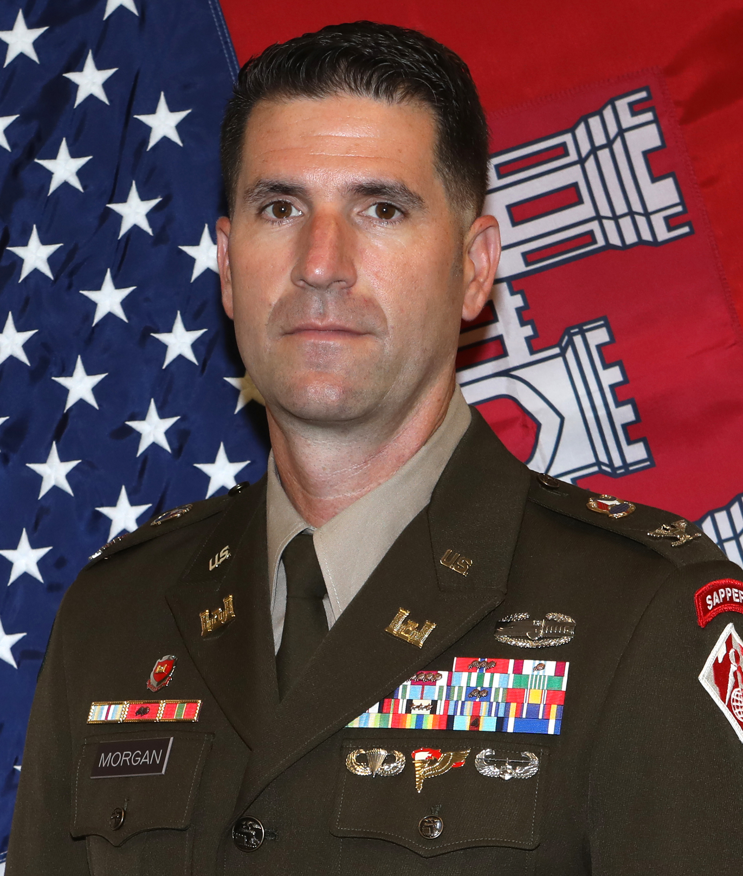
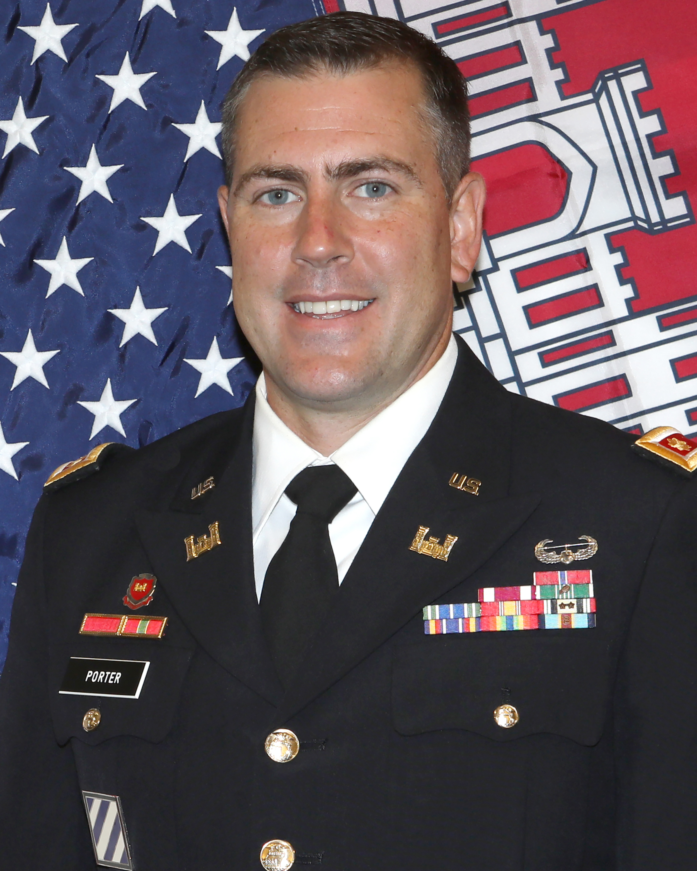
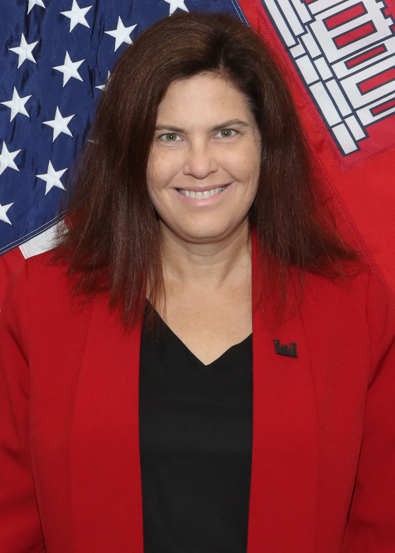
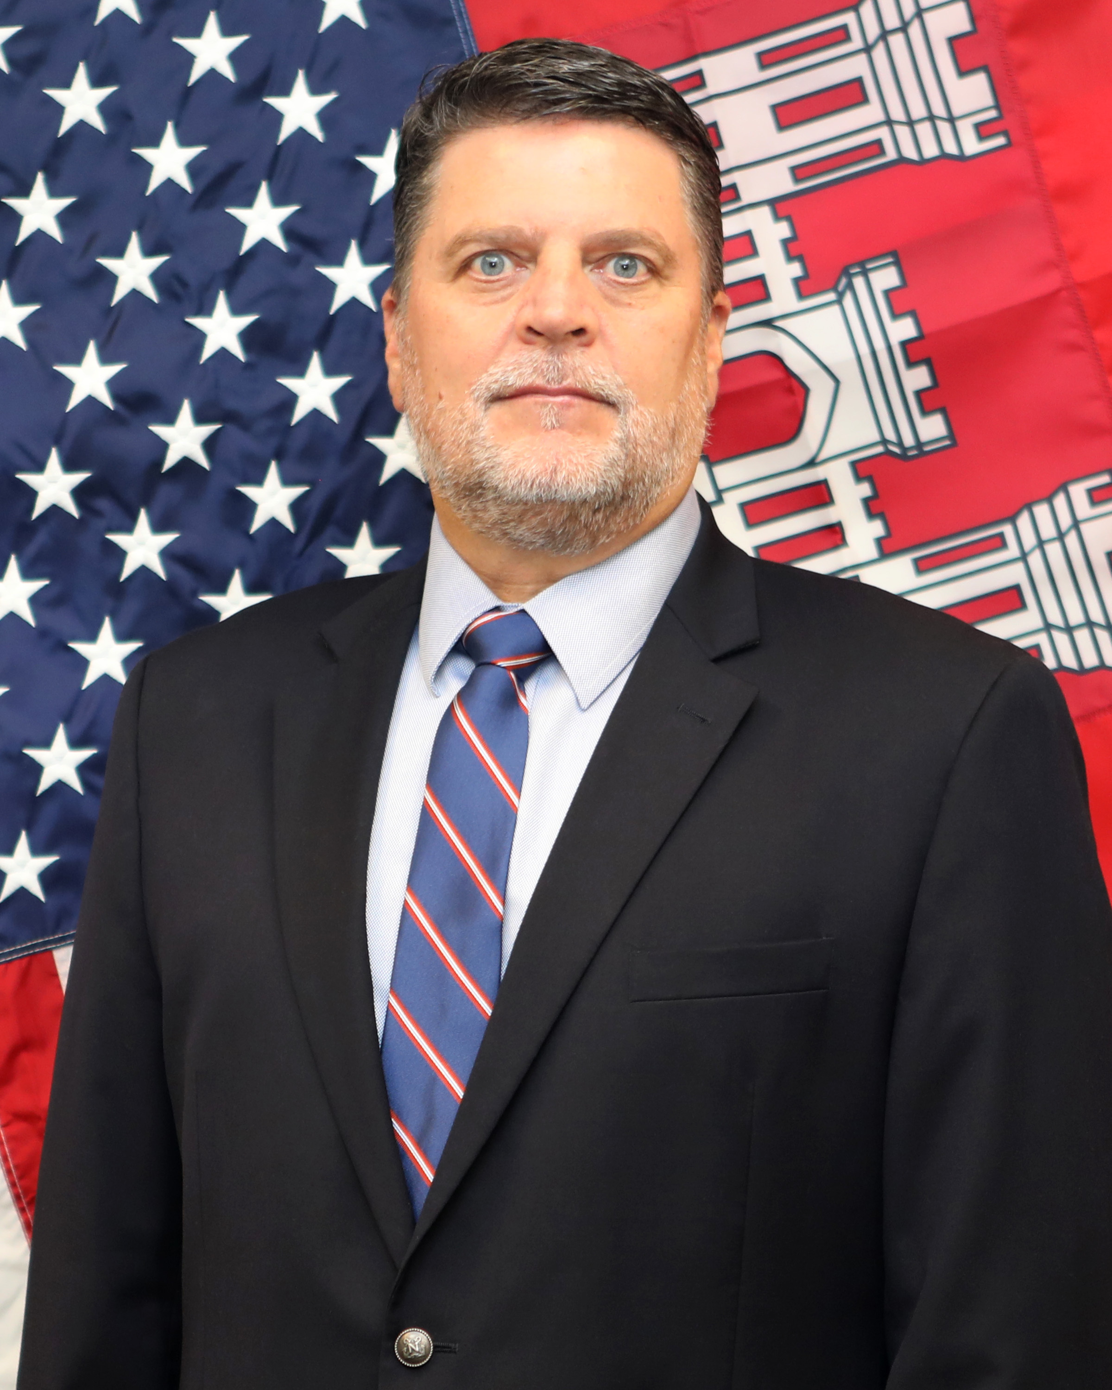
Wilmington District Leadership
COL Brad Morgan
District Commander
LTC Kenneth Porter
District Deputy Commander
Ms. Christine Brayman
Deputy District Engineer
Programs and Project Management
Mr. John Mayo
Chief, District Contract Division

Slide 3
The Wilmington District AOR
Military
Fort Bragg - Military Construction for Special Operations Commands (MILCON & SRM Funded)
Military Ocean Terminal Sunny Point (MOTSU) - SRM Funded Construction and Service Contracts (Environmental & Base Maintenance)
Civil Works
Operation and Maintenance Dredging along the NC Coast
  MOTSU
  State Ports of Morehead City and Wilmington
  Atlantic Intracoastal Waterway (AIWW) & Other Federal Navigation Channels
Coastal Storm Risk Mitigation (CSRM)
Operation of two Hydropower Plants in Virginia (Philpott and John H Kerr)
Operation of five lakes and dam recreational areas; 3 in NC, 2 in VA. All built for flood risk management
Shallow Draft Dredge fleet that works from Maine to Texas
Working Today to Build a Better Tomorrow

Slide 4
MILCON Forecast – fort Bragg
FY | Project | Location | Value | Solicitation | Acquisition Strategy | Estimated Advertise Date
25 | SOF Arms Room Addition | SOTF | $10M - $25M | Small Business | DBB | FY25 3rd QTR
26 | Mission Command Center | JSOC | $100M – $150M | TBD | DBB | FY26 1st QTR
27 | SOF Equipment Development Facility | ATF | $25M - $50M | TBD | DBB | FY27 2nd QTR
27 | SOF Ammo Supply Point Phase 1 | SOTF | Phase 1 $50M - $100M | TBD | DBB | FY27 3rd QTR
27 | FOB Freedom Upgrades | Camp Mackall | $20 - $50M | TBD | DBB | FY27 2nd QTR
28 | SOF Ammo Supply Point Phase 2 | SOTF | Phase 2 $25M - $50M | TBD | DBB | FY28 1st QTR
29 | SOF SERE Training Facility | ATF | $10M - $25M | TBD | DBB | FY29 1st QTR
Note: Forecast information provided is an estimate. Acquisition strategies may vary depending upon the results of formal market research.

Slide 5
MOTSU and Other Forecast
FY | Location | Project | Value | Solicitation | Acquisition Strategy | Estimated Advertise Date
25 | Base Maintenance Contract | MOTSU | $10M - $25M | Small Business | DBB | FY25 4th QTR
25 | SAW | Berm Construction | TBD | TBD | TBD | FY25 4th QTR
25 | MOTSU | Ammo Berm/Pad Repair | $5-$15M | TBD / IFB | TBD | FY25 4th QTR
26 | Raleigh/NCSU | USDA Agriculture Research Service | $25M - $35M | Unrestricted | DBB - LPTA | FY26 1st QTR
Note: Forecast information provided is an estimate. Acquisition strategies may vary depending upon the results of formal market research.

Slide 6
Forecast - CIVIL WORKS Programs
CONSTRUCTION AND o&m
FY | Location | Project Name | Value | Solicitation | Acquisition Strategy | Estimated Advertise Date
25 | Atlantic Intracoastal Waterway (AIWW), NC | Snow’s Cut Erosion Control (Repair) Contract | $10M - $15M | TBD | IFB | FY26 4th QTR
25 | Atlantic Intracoastal Waterway (AIWW), NC | AIWW Disposal Area Contract | $3M - $5M | Small Business | IFB | FY25 4th QTR
25 | Atlantic Intracoastal Waterway (AIWW), NC | AIWW Maintenance Dredging Contract | $5M - $10M | Small Business | IFB | FY25 4th QTR
25 | Greenville, NC | Greenville Utilities Commission (GUC) Streambank Protection Contract | $3M - $5M | Small Business | IFB | FY25 4th QTR
25 | MOTSU | MOTSU Maintenance Dredging Contract | $3M - $7M | UR | IFB | FY25 3rd QTR
Note: Forecast information provided is an estimate. Acquisition strategies may vary depending upon the results of formal market research.

Slide 7
Forecast - CIVIL WORKS Programs
CONSTRUCTION AND o&m
FY | Location | Project Name | Value | Solicitation | Acquisition Strategy | Estimated Advertise Date
25 | Outer Banks, NC | Rollinson Channel / Silver Lake Harbor Maintenance Dredging Contract | $8M - $12M | Small Business | IFB | FY25 4th QTR
25 | South Atlantic Division | Regional Harbor Dredging Contract (RHDC)(1 or 2 Contracts) | $20M - $35M | UR | IFB | FY25 4th QTR
25 | Wilmington Harbor, NC | Anchorage Basin / Mid-River Maintenance Dredging Contract | $10M - $15M | UR | IFB | FY25 4th QTR
Note: Forecast information provided is an estimate. Acquisition strategies may vary depending upon the results of formal market research.

Slide 8
Upcoming idiq contracts
FY | Location | Project | Value | Solicitation | Estimated Advertise Date
FY26 | SAW | Survey & mapping | $5M Base Year plus 4 Option Years | Small Business | FY25 3QTR
FY26 | MOTSU | DB/General Construction | $24.5M Base Year plus 4 Option Years | Small Business | FY25 4QTR
FY26 | Fort Bragg | DB/General Construction | $24.5M Base Year plus 4 Option Years | Small Business | FY25 4QTR
FY27 | MOTSU | AE Environmental Services | $7M Base Year plus 4 Option Years | Small Business | FY26 1QTR
Note: Forecast information provided is an estimate. Acquisition strategies may vary depending upon the results of formal market research.

Slide 9
ROAD TO SUCCESS
Check www.sam.gov and eBuy websites frequently.
  Wilmington District DoDAAC is W912PM*
Keep information current in System for Award Management (SAM) and in the SBA’s Dynamic Small Business Search
  We can’t award to you if you are not in the system.
Respond to Business Opportunity Notifications
  Sources Sought - You could be the response needed to show ample competition.
  Review announcements – industry days, and locally/federally attended meetings in the area

Slide 10
ROAD TO SUCCESS
Conduct market research in www.sam.gov to find out what each organization purchases.
Follow Instructions in solicitations documents.
  If solicitation has 10-page limit, stay under 10 pages.
Request a debrief
  Even if you are the awardee. Knowledge is key!
Find your local Apex Accelerator for assistance
Schedule a meeting or Capability Brief with the Small Business Office

Slide 11
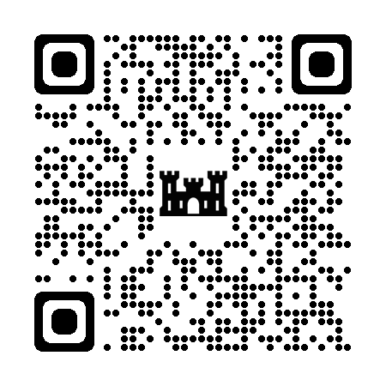
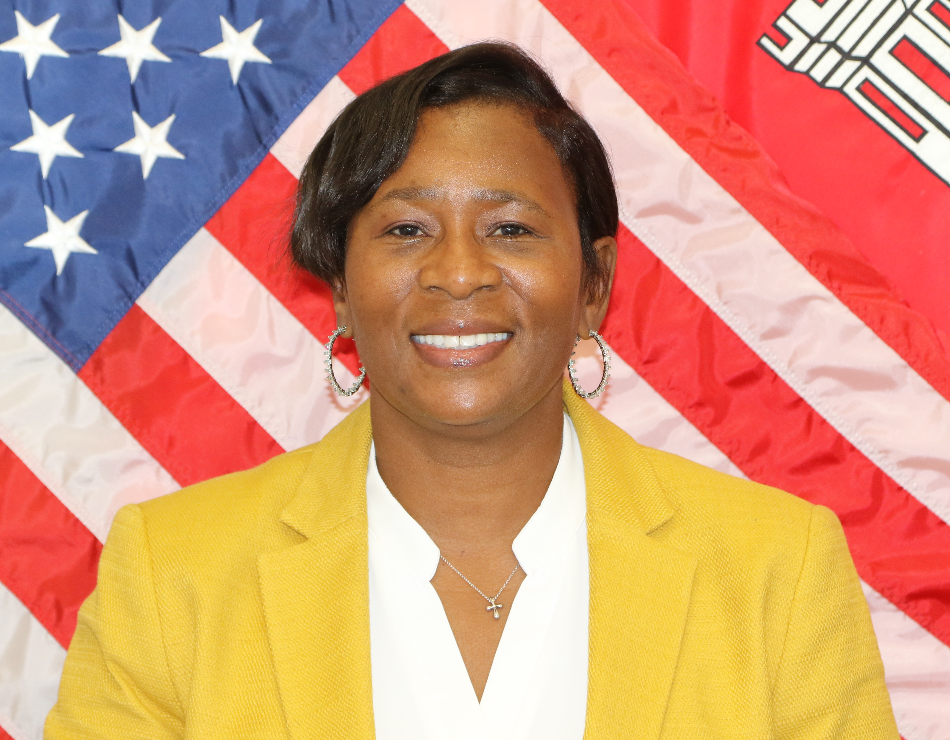
Contact Information
Andrea M. Green
Chief of Small Business Programs
USACE, Wilmington District
Office: (910)251-4452 / Mobile: 910-787-0340
Small Business Email: cesaw-sb@usace.army.mil

Slide 12


